Slide 1
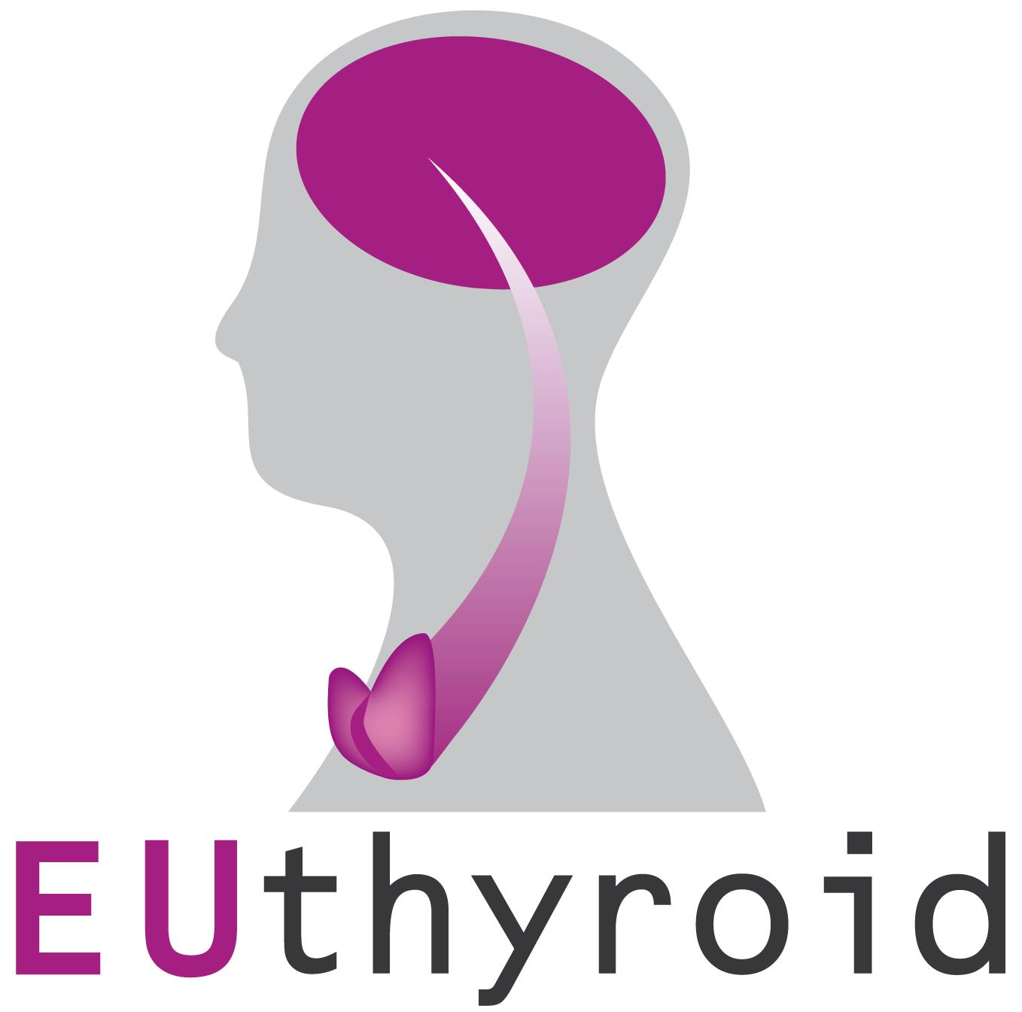
EUthyroid
Outcomes, Recommendations & Next Steps
16 June, Brussels
Presentation to the European Commission –
DG RTD Unit E1 Healthy Lives, HoU Anna Lonnroth

Slide 2
Table of Contents
Iodine Intake: Also a European Problem
About Euthyroid and the Krakow Declaration on Iodine
Digital Webinar on the Krakow Declaration on Iodine
Towards an EUthyroid 2 in the Context of Horizon Europe?

Slide 3
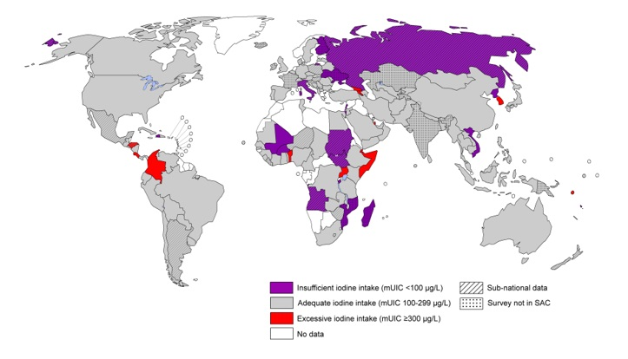
1. Iodine Intake: Also a European Problem
www.ign.org
This project has received funding from the European Union’s Horizon 2020 research and innovation programme under grant agreement No 634453.

Slide 4
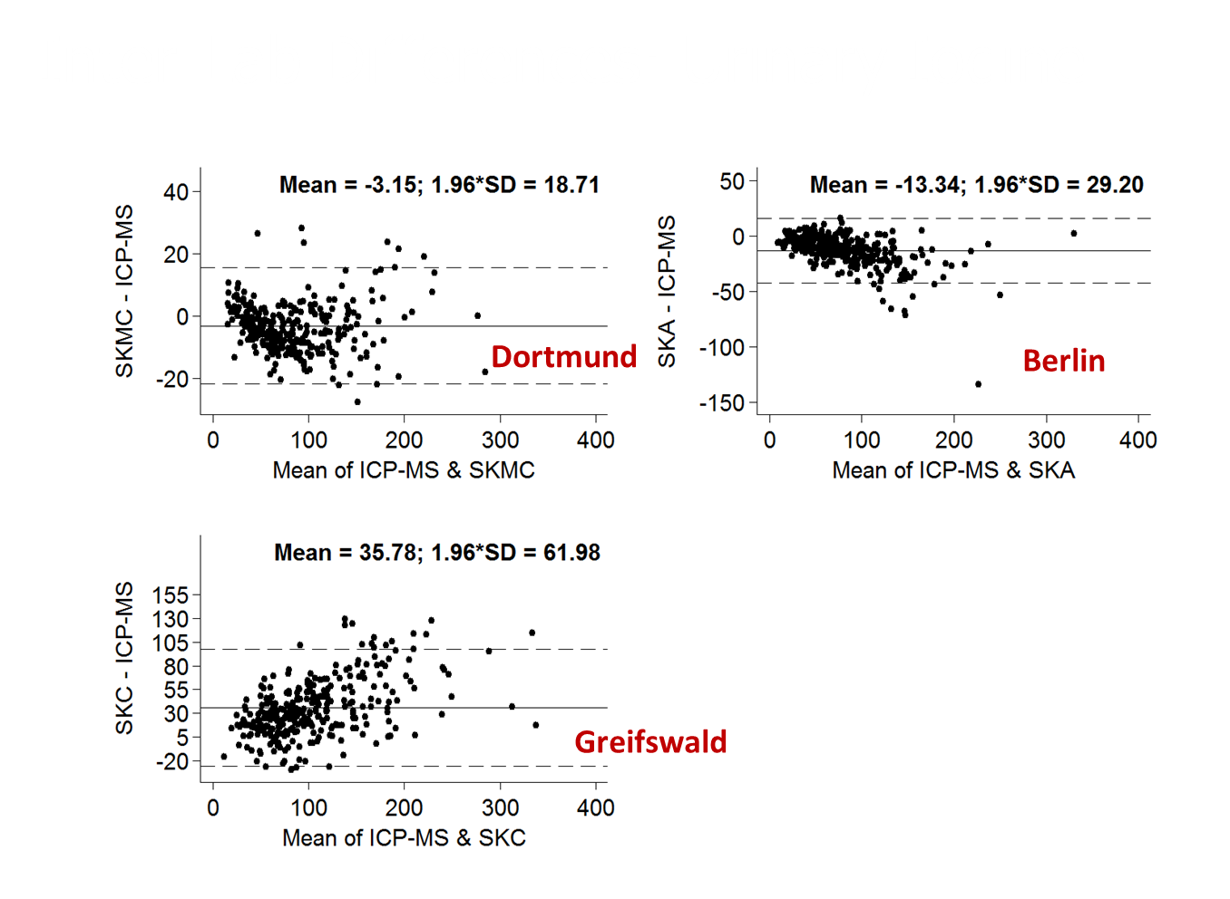
1. Iodine Intake: Also a European Problem
This project has received funding from the European Union’s Horizon 2020 research and innovation programme under grant agreement No 634453.
Ittermann et al. Clin Chem Lab Med 2018

Slide 5
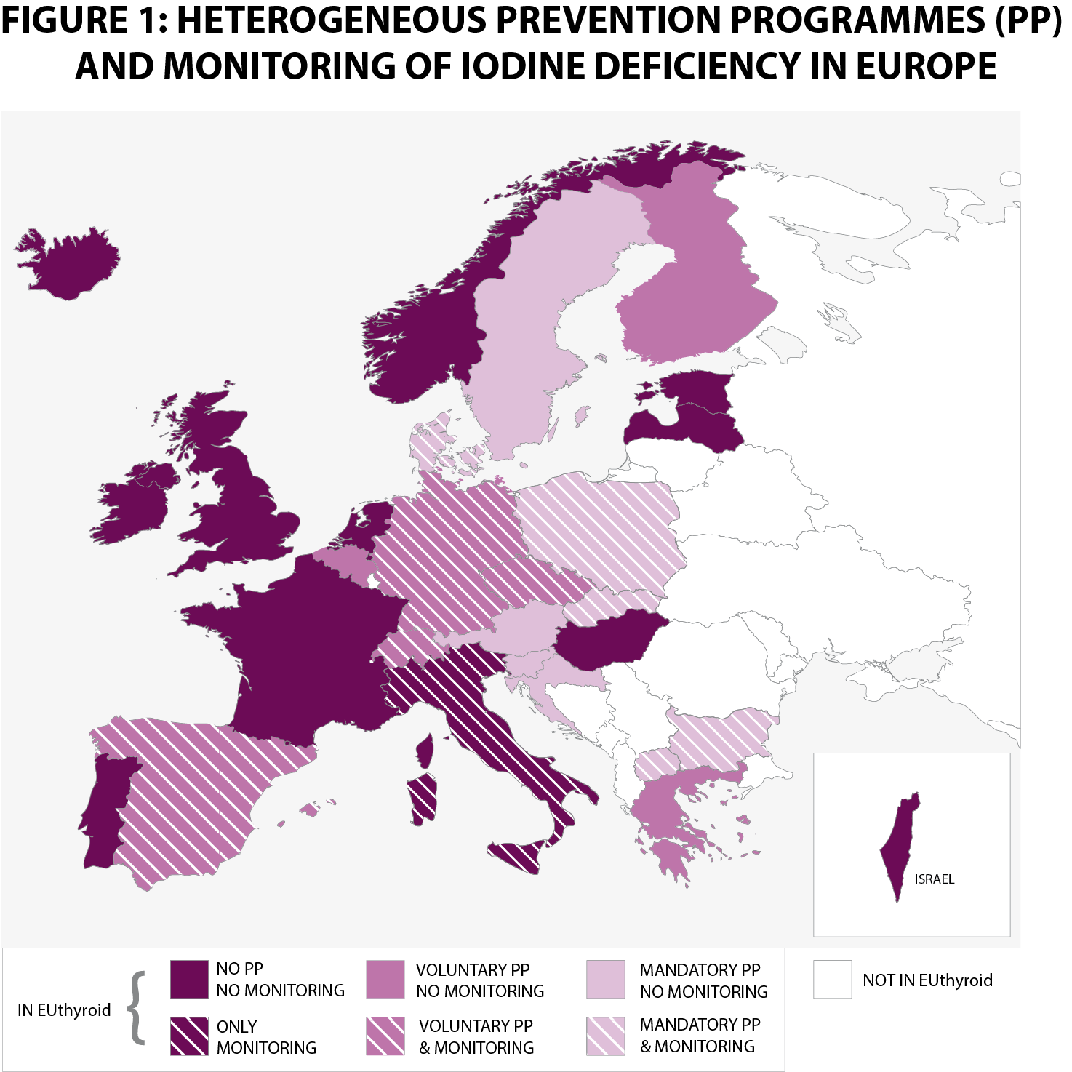
1. Iodine Intake: Also a European Problem
Heterogeneity of IDD Prevention and Monitoring Programmes
None, voluntary, mandatory
Iodate, iodide
Fortification of different nutrients
Different target concentrations
Different population reach (5 - 80%)
National or regional legal regulations
High variability of biomarkers
Low external validity
No biomarker to measure the longer-term iodine status
Few and varying findings on socioeconomic gradients
Nearly no outcome research
Low evidence level for cost-efficiency of IDD prevention
Lazarus J. Eur Thyroid J 2014
This project has received funding from the European Union’s Horizon 2020 research and innovation programme under grant agreement No 634453.

Slide 6
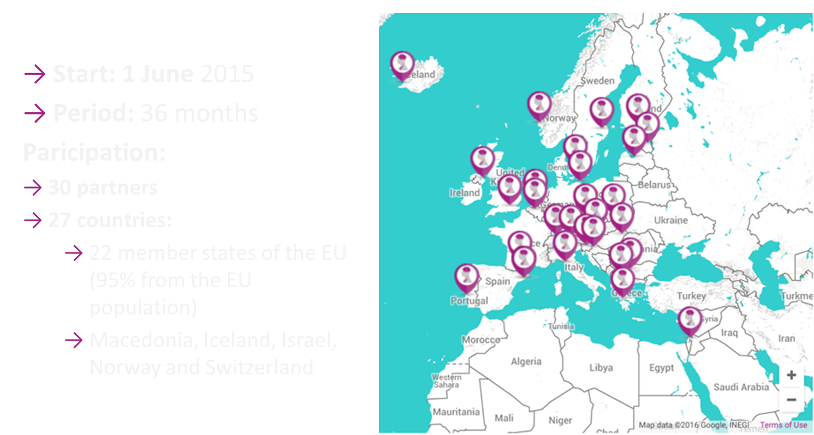
2. About Euthyroid and the Krakow Declaration on Iodine
This project has received funding from the European Union’s Horizon 2020 research and innovation programme under grant agreement No 634453.

Slide 7
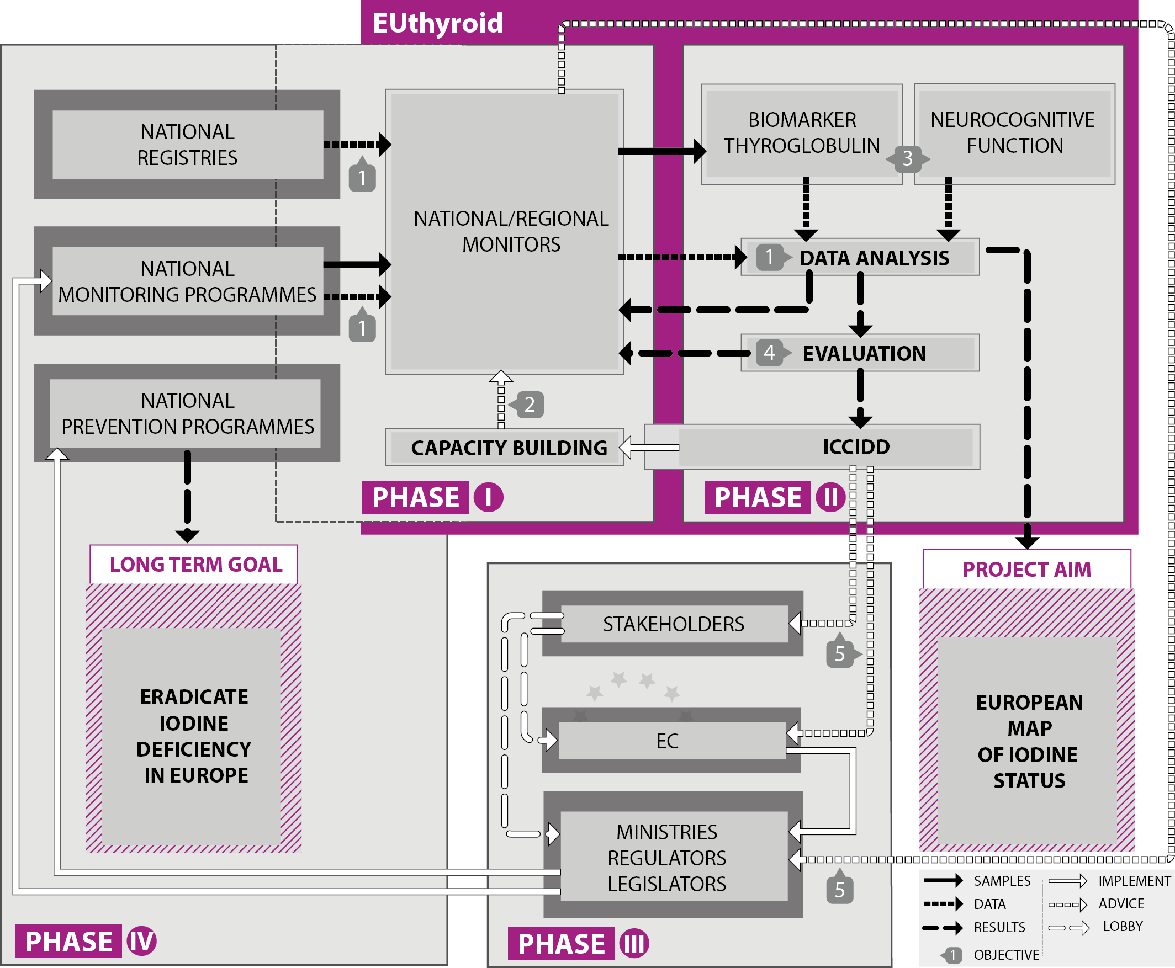
2. About Euthyroid and the Krakow Declaration on Iodine
Objectives of EUthyroid
To develop a European map of iodine status
To build the capacity of national studies to perform harmonised studies
To establish thyroglobulin as iodine status marker
To provide evidence for effectiveness of IDD prevention
To disseminate EUthyroid outcomes
This project has received funding from the European Union’s Horizon 2020 research and innovation programme under grant agreement No 634453.

Slide 8
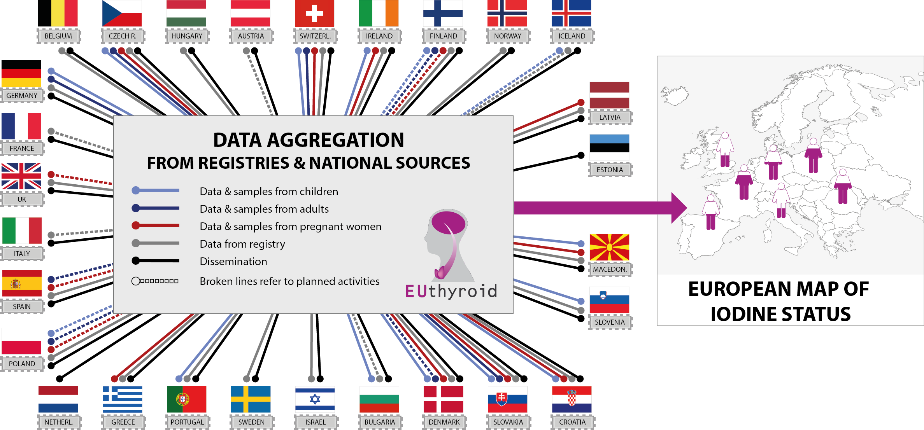
2. About Euthyroid and the Krakow Declaration on Iodine
Pan-European Approach
This project has received funding from the European Union’s Horizon 2020 research and innovation programme under grant agreement No 634453.

Slide 9
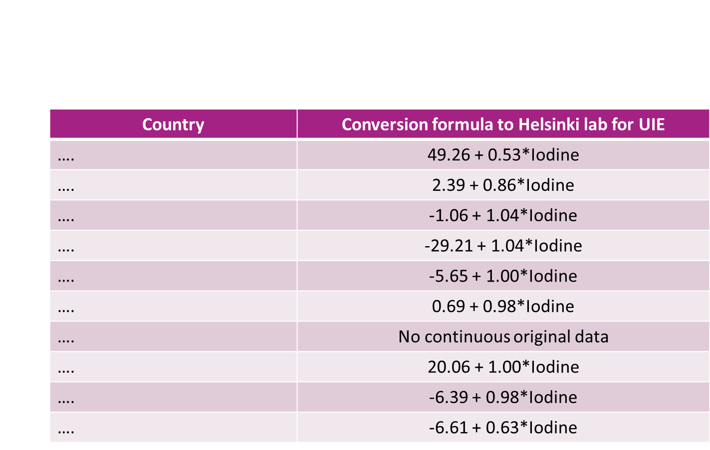
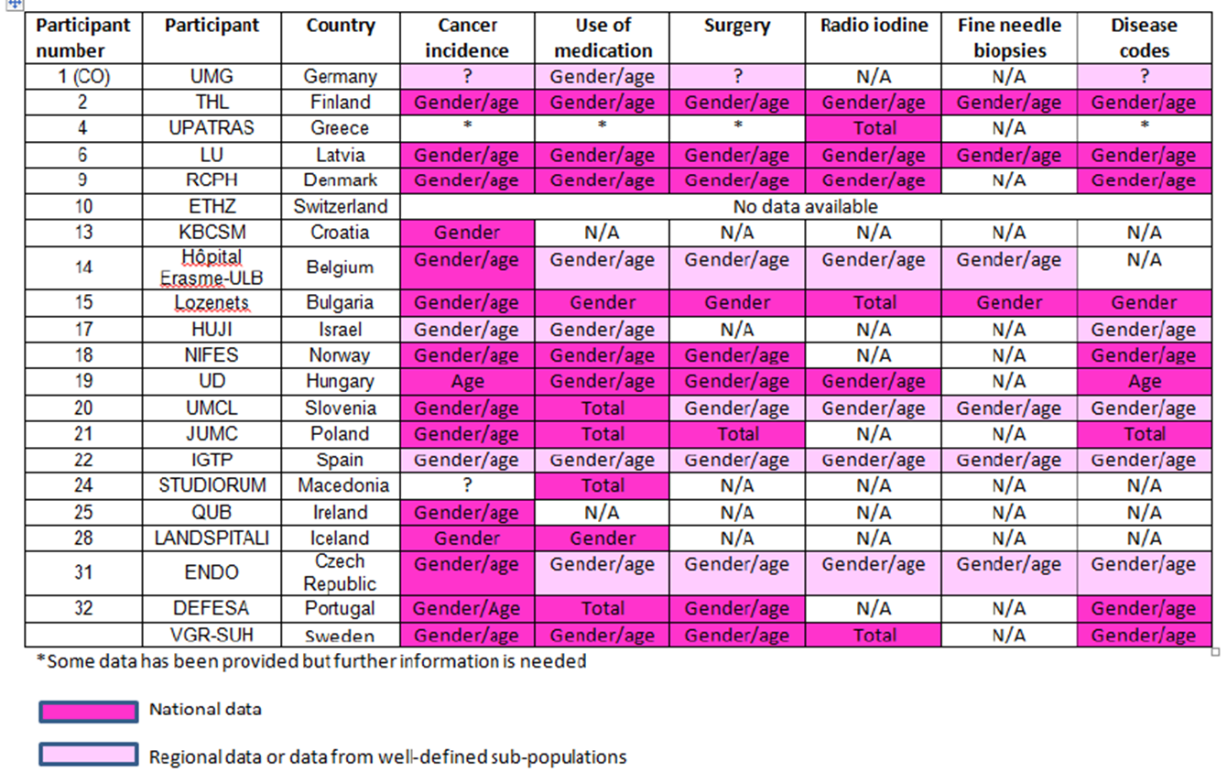
2. About Euthyroid and the Krakow Declaration on Iodine
Results: Difference in
Inter-Lab UIC Measurement
Results: Different National Data Registry
This project has received funding from the European Union’s Horizon 2020 research and innovation programme under grant agreement No 634453.

Slide 10
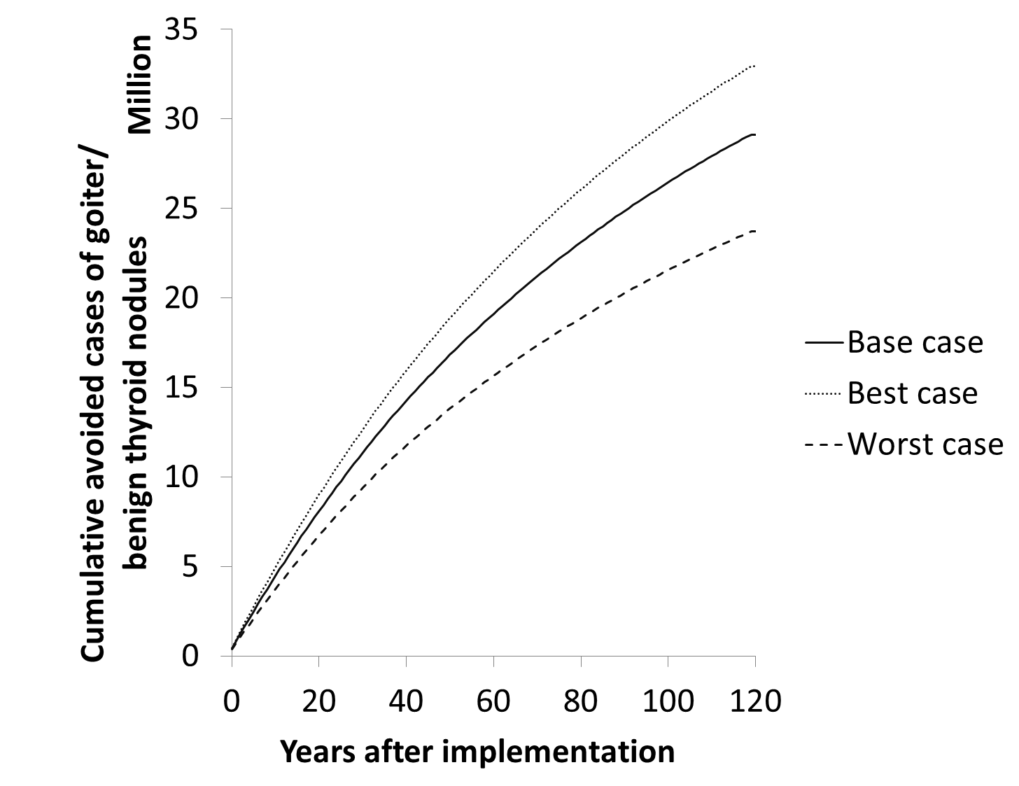
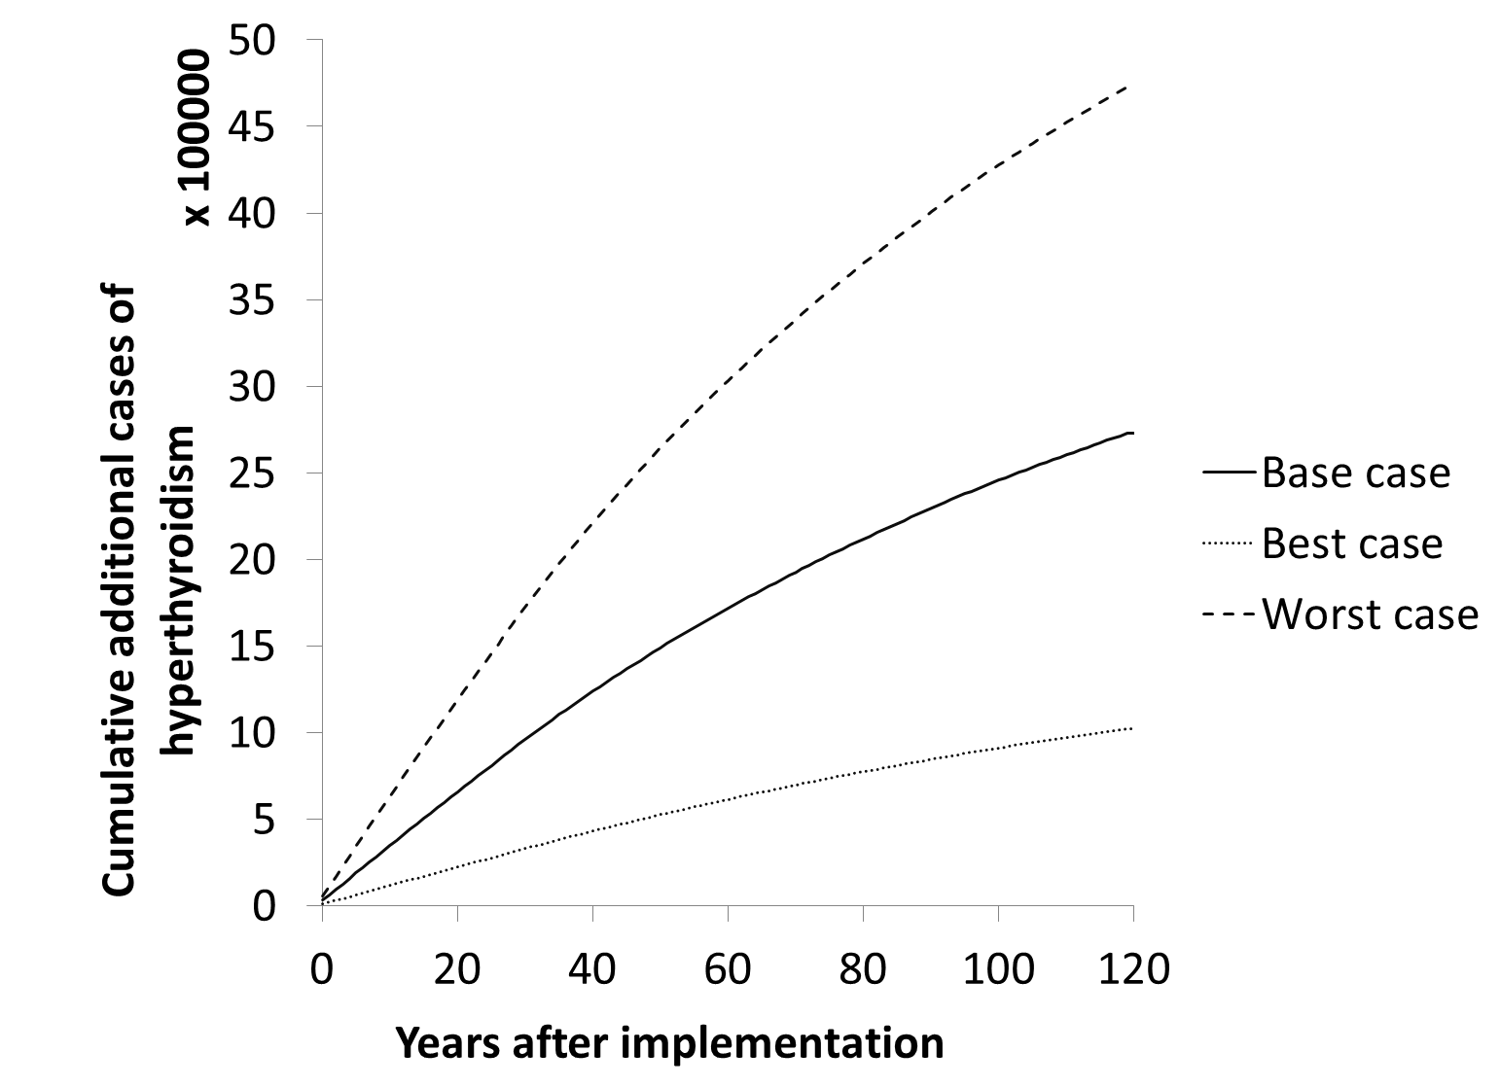
2. About Euthyroid and the Krakow Declaration on Iodine
Results: Effectiveness of IDD Prevention
Schaffner et al., in review
This project has received funding from the European Union’s Horizon 2020 research and innovation programme under grant agreement No 634453.

Slide 11
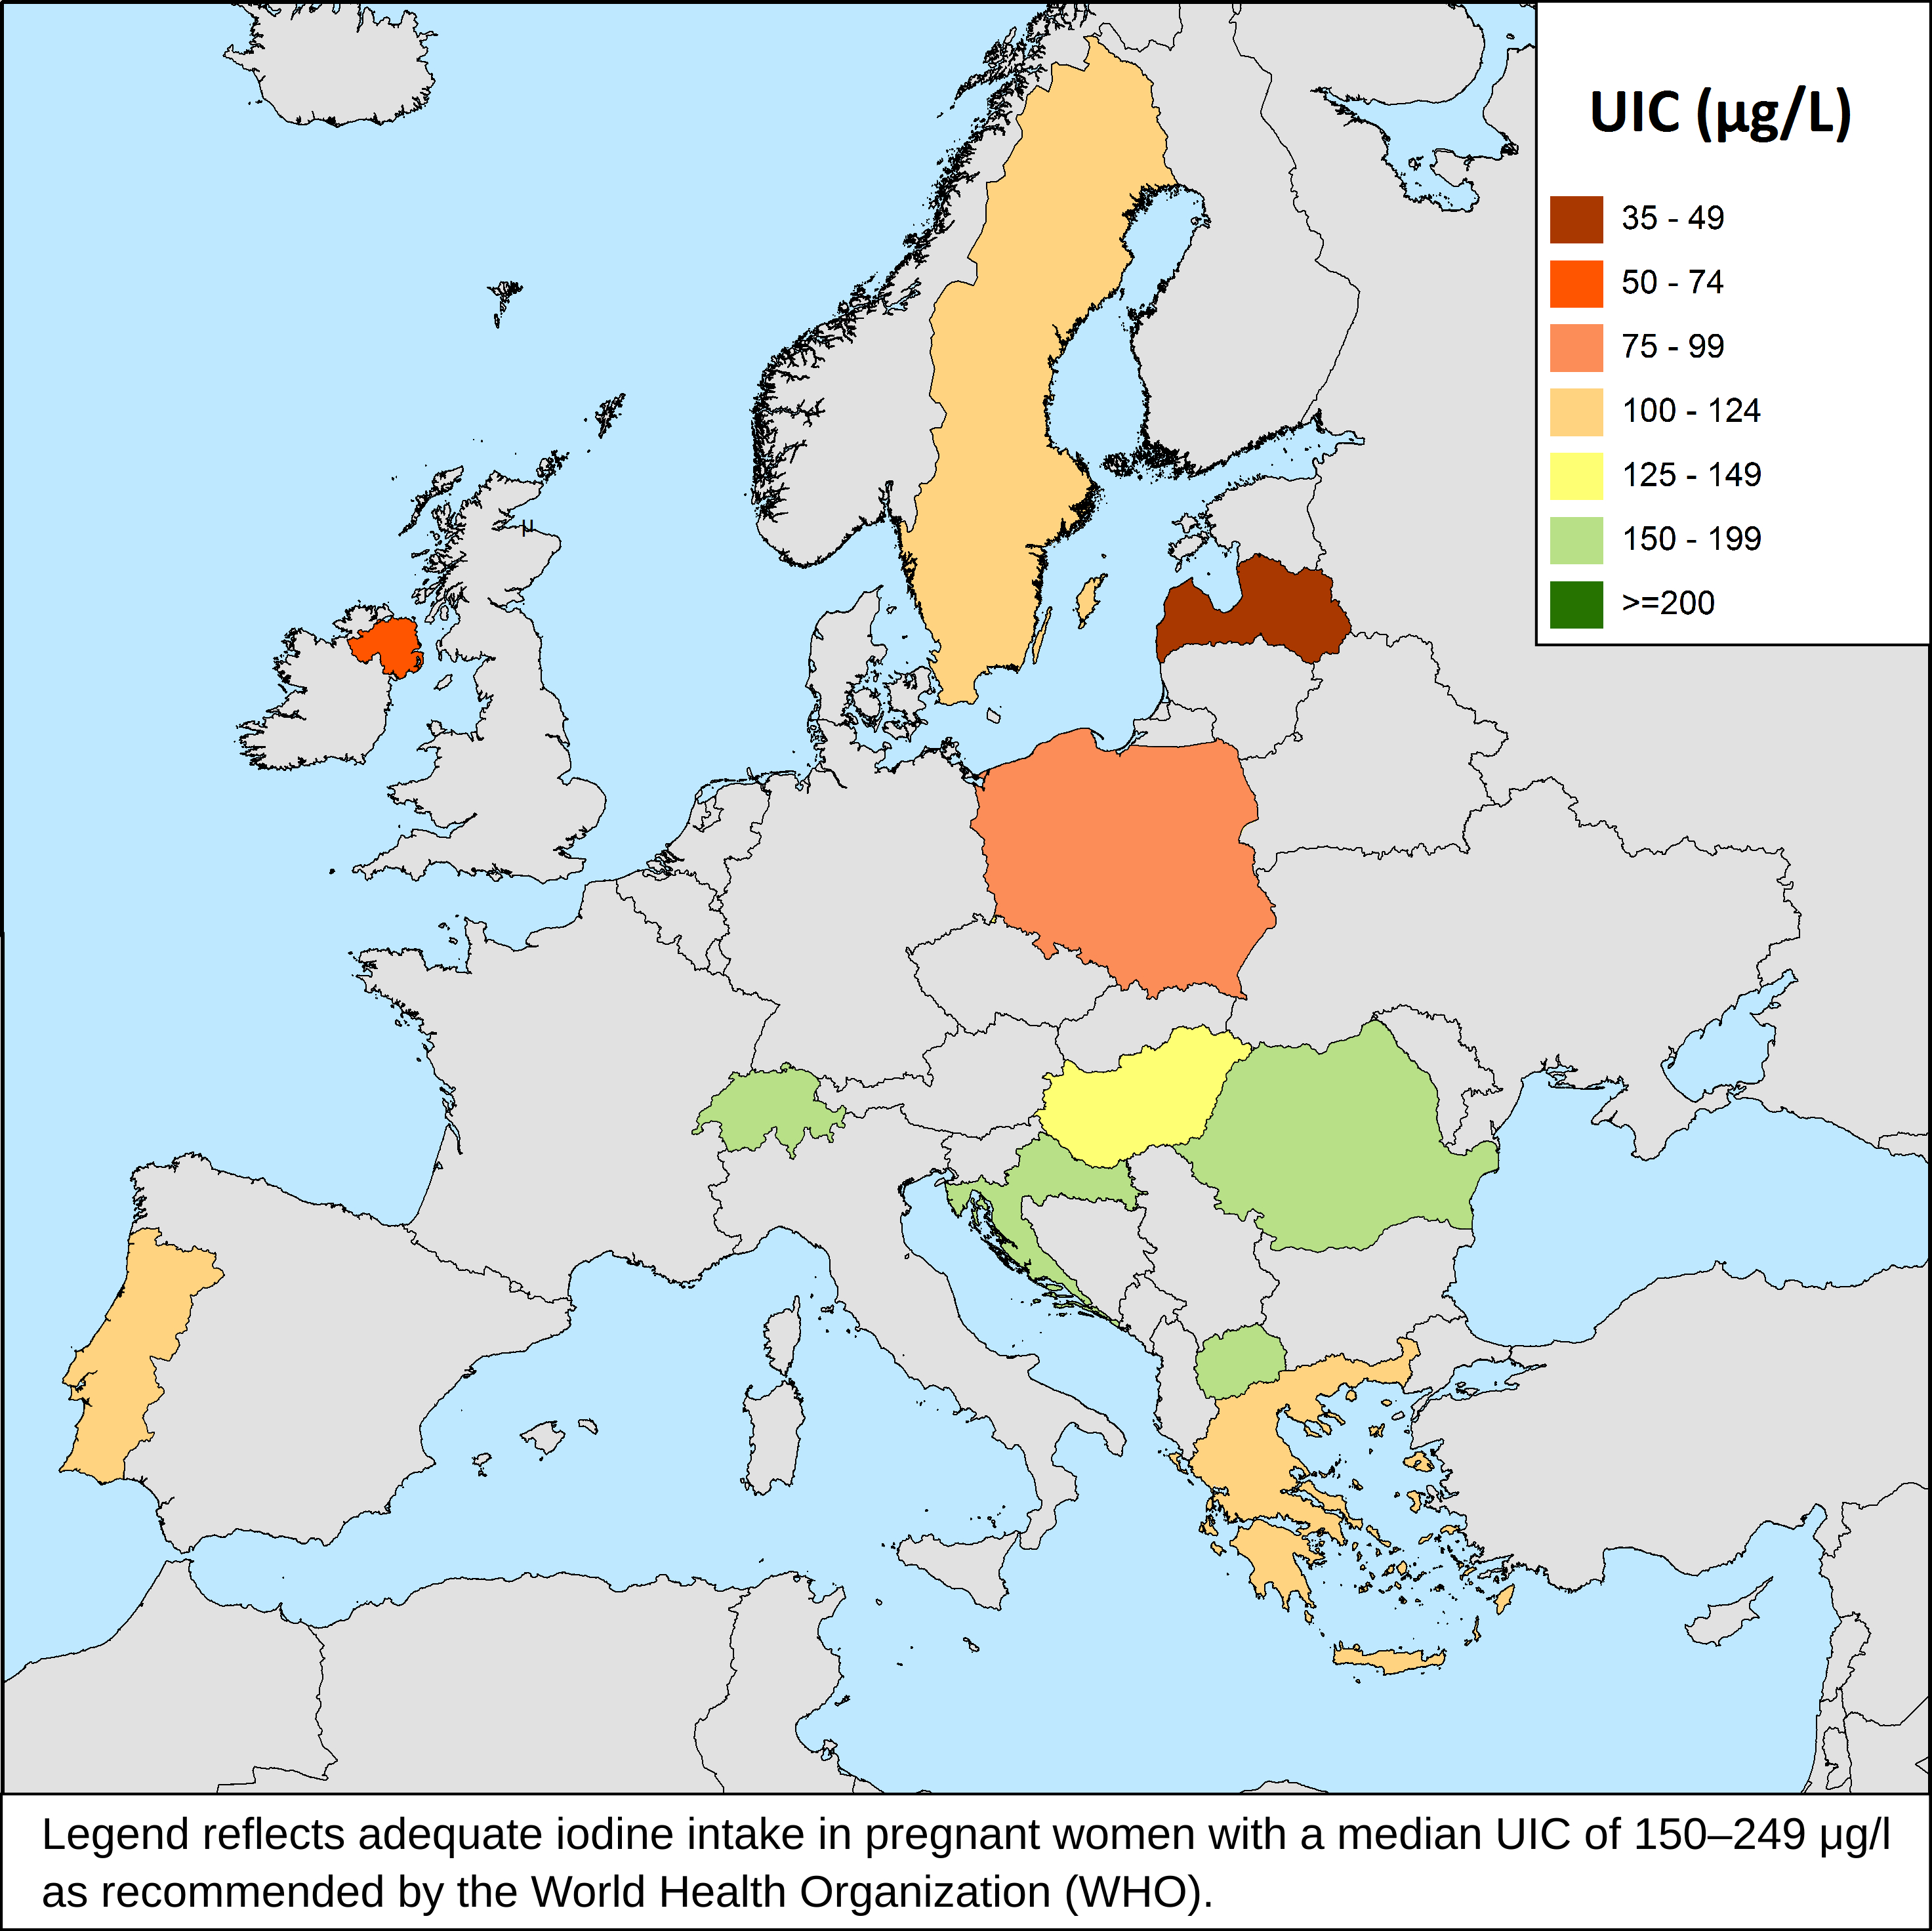
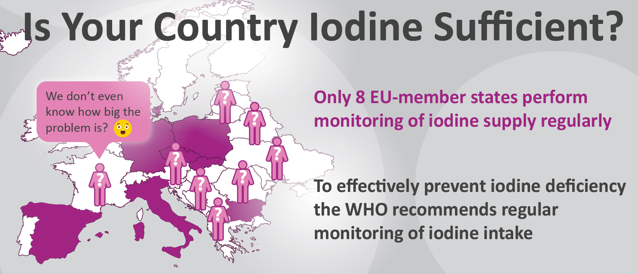
2. About Euthyroid and the Krakow Declaration on Iodine
Results: Effectiveness of Monitoring Programmes
Ittermann, 2020
This project has received funding from the European Union’s Horizon 2020 research and innovation programme under grant agreement No 634453.

Slide 12
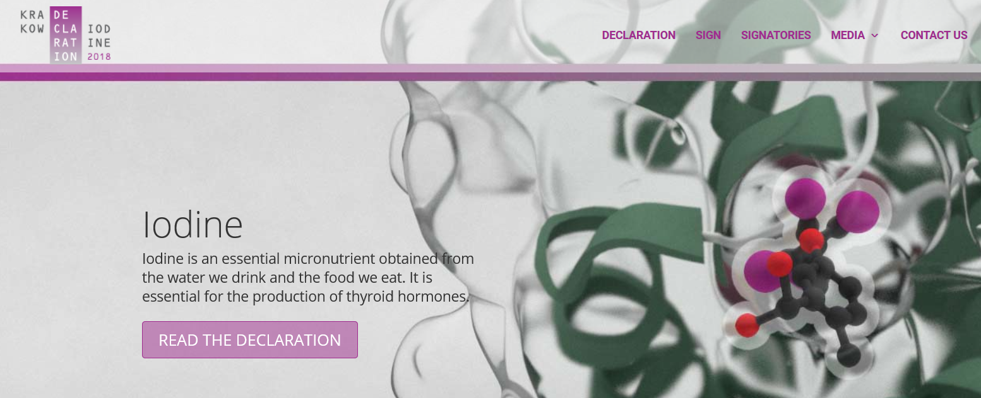
2. About Euthyroid and the Krakow Declaration on Iodine
www.iodinedeclaration.eu
Signed by 76 organisations, globally
(scientific, medical and patients)
Scientists concluded that up to 50% of the new-borns in Europe might not reach their full cognitive potential due to insufficient iodine intake
This project has received funding from the European Union’s Horizon 2020 research and innovation programme under grant agreement No 634453.

Slide 13
2. About Euthyroid and the Krakow Declaration on Iodine
Methods of IDD Prevention
Regulators and policymakers should harmonize the EU regulatory framework to ensure free trade of fortified foodstuffs in Europe. Similarly, iodized animal feed requires regulatory approval to ensure free trade within the EU.
Control of IDD Prevention
National governments and public health officials should harmonize monitoring and evaluation of fortification programs at regular intervals to ensure optimal iodine supply to the public.
Support for IDD Prevention
Scientists, together with the medical community, patient organizations and industry, should support measures necessary to ensure that IDD prevention programs are appropriate within a rapidly changing environment and further social awareness about the issue.
This project has received funding from the European Union’s Horizon 2020 research and innovation programme under grant agreement No 634453.

Slide 14
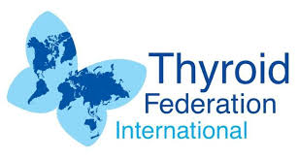
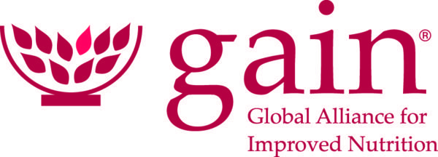
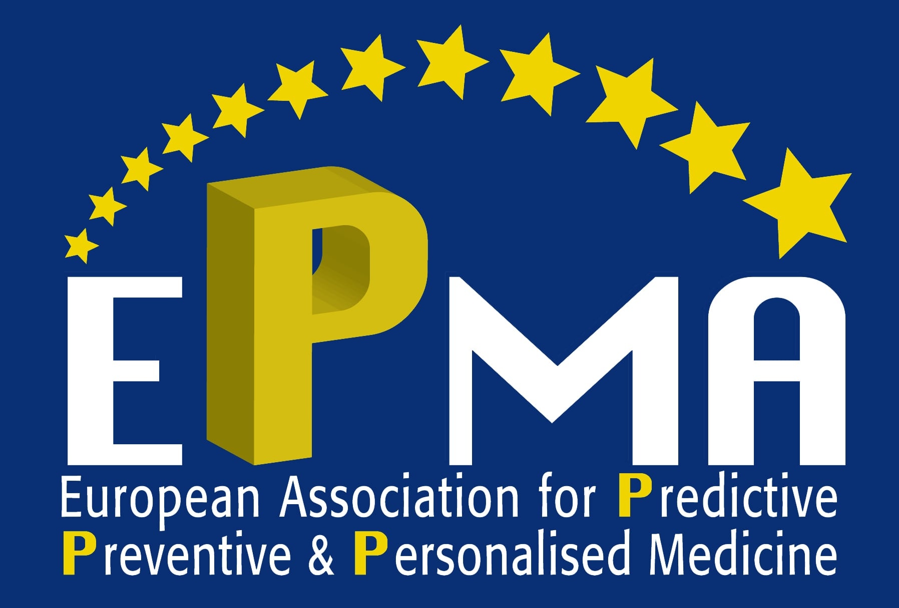
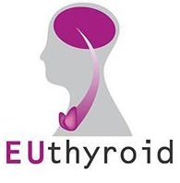
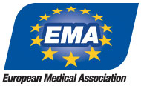
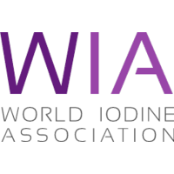
3. Digital Webinar on the Krakow Declaration on Iodine
Food Fortification:
Salt iodisation
Process food supplementation
Increase iodine content in crops and vegetables
Feed Fortification
This project has received funding from the European Union’s Horizon 2020 research and innovation programme under grant agreement No 634453.

Slide 15
4. Towards an EUthyroid 2 in the Context of Horizon Europe?
Towards a new type of combined intervention and observation studies could support the identification of the hurdles that prevent fertile and pregnant women, as well as young mothers and babies (up-to 1,000 days) from receiving proper iodine intake.
Adequate data infrastructures have to be consolidated and data sources provided for analyses of effectiveness and the monitoring of potential harms. Also, solutions should be pursued for the harmonisation on the collection, measurement and assessment of data on IDD throughout European Member States.
Notes:
Current conventional prevention programmes have a limited impact for preventing iodine deficiency occurring in the early stages of life. Consequently, a new type of combined intervention and observation studies could support the identification of the hurdles that prevent fertile and pregnant women, as well as young mothers and babies (up-to 1,000 days) from receiving proper iodine intake. Such a research should integrate a panel of young women from different European regions who would be associated to the research and its communication activities. This approach could improve the knowledge base on iodine deficiency in categories of the European population that are at risks and should be underpinned by adequate awareness campaign targeting these categories in light of their country specificities.
Existing IDD prevention programmes are based on observing primary outcomes of the prevention strategy including any trend in incident thyroid diseases and related treatments. Hence, adequate data infrastructures have to be consolidated and data sources provided for analyses of effectiveness and the monitoring of potential harms. Also, solutions should be pursued for the harmonisation on the collection, measurement and assessment of data on IDD throughout European Member States.

Slide 16
Thank you
Prof. Henry Völzke, Euthyroid Coordinator
University of Greifswald, Germany
voelzke@uni-greifswald.de

