Slide 1

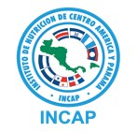
Webinar
Guía para el monitoreo de la yodación de sal y del estado en yodo de la población: lecciones aprendidas y recomendaciones para mejorarlo
16 de enero, 2020

Slide 2
introducción
Bienvenida
  Maikee Arts. Jefa de Sobrevivir y Prosperar, Oficina Regional de UNICEF para América Latina y el Caribe
  Dr. Manolo Mazariegos, Coordinador de la Unidad de Nutrición y Micronutrientes, INCAP
  Metodología del webinar
Contexto de los programas de nutrición de yodo – Carolina Martínez/INCAP
Programas de yodación de la sal
Qué ha cambiado en los programas de nutrición de yodo
Implicaciones para qué y cómo se monitorea el desempeño e impacto
Principales recomendaciones del documento de la Guía y cómo se pueden aplicar en el programa de nutrición de yodo – Ivette Sandino/IGN
Preguntas y comentarios
Notes:
Welcome to the webinar on the Guidance on the Monitoring of Salt Iodization Programmes and Determination of Population Iodine Status.
What can you expect?
In the next hour we will have a presentation on the UNICEF “Guidance on monitoring salt iodization programmes and iodine satus” that was issued in 2018.
The presentation will last about 40 minutes.
After that there will be room for your questions and comments - for about 20 minutes.
We will try to monitor the questions that you can post in the chat box throughout the presentation. We will try to cover all questions we receive.
You will be muted centrally during the webinar. We will record the entire webinar and we will share this together with the presentation and other materials by email with all participants.
This webinar is organized jointly by UNICEF and the Iodine Global Network (IGN). IGN has led the development of the materials used for this webinar.
We are happy to have regional representation from both UNICEF and IGN in this webinar
Let me take a moment to introduce the speakers and myself:
Joan Matji from UNICEF ESARO
Festo Kevishe from the Iodine Global Network. He is the regional coordinator.
Mawuli Sablah who is a nutrition specialist based in UNICEF HQ
Jonathan Gorstein who is the executive director of IGN, out of Seattle US.
I am Arnold Timmer, I work with IGN, and am the moderator for this webinar
So, let us get started.
In the next hour you will hear about
Salt iodization programs
What has changed over time in iodine nutrition programs
Its implications for what and how we monitor performance and impact
What the key recommendations are from Guidance document
How you can use them in your work as program manager
I would like to emphasize that we will not be able to cover all the program aspects of iodine nutrition.
There are many many dimensions and experiences to this exciting program but that would take a long time to discuss…
We understand you will have other questions. We do want to hear these and we will respond separately.
UNICEF, IGN and other organization such as NI, GAIN, WFP are supporting iodine programs so please seek also advice from them.
So now, let me give the floor to Joan Matji from UNICEF to say a few words on behalf of UNICEF.

Slide 3
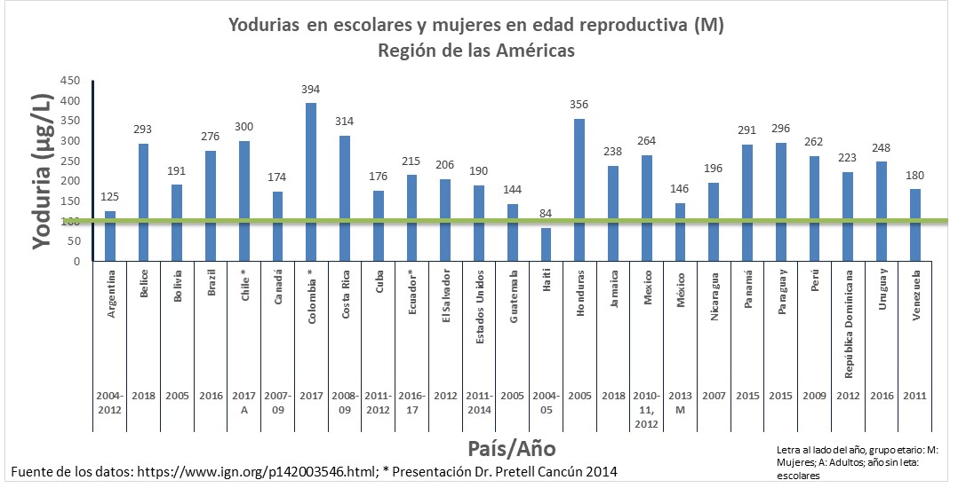
CONTEXTO GLOBAL: Fortificación de la sal con Yodo, ESTrAtEGIA EXITOSA PARA ELIMINAR LOS DDY
Estrategia: Fortificación de la sal con yodo
Generación evidencia/ información
Yodurias
META COMUN
Combatir los Desórdenes por Deficiencia de Yodo
Vigilancia
Legislación adecuada
Investigación y desarrollo
Monitoreo
Proceso de revisión y ajustes
ALIANZAS PUBLICO PRIVADAS
Acompañamiento de instituciones técnicas

Slide 4
Nutrición óptima de yodo para todos, no solamente prevención de los ddy
Enfoque inicial de los programas de yodación de sal: Prevenir los DDY (signos clínicos como bocio)
Estudios en los años 80 demostraron que la deficiencia de yodo afecta irreversiblemente el desarrollo del cerebro durante el embarazo.
→ Enfoque cambió a incluir signos visibles y no visibles
→ Enfoque cambió a un estado óptimo de yodo para todos
El aumento en la generación de información de los programas han demostrado que la deficiencia de yodo ha disminuido pero hay un aumento de la ingesta de yodo más de lo adecuado.
→ Enfoque actual: Nutrición óptima de yodo para todos. Ni tan poco, ni mucho.
Se necesitan herramientas y guías para dar un mejor seguimiento a los programas de yodación de la sal y asegurar la nutrición óptima de yodo para todos.
Notes:
What have been the main milestones in iodine programming?
When USI programs began, the focus was on providing adequate iodine to prevent deficiency disorders (clinical signs like goiter), particularly in school age children
Studies in the 1980s showed the detrimental effect iodine deficiency has on brain development and focus shifted to all consequences to include the pregnancy period
As programs matured and more data on iodine status became available, deficiency decreased but some programs reported more than adequate intakes. Like inadequate intakes, this needs to be avoided because it affects thyroid function in a negative way → the focus of programs and program monitoring shifted to ensure adequate intake for all – not too little and not too much - hence the term ‘Optimal Iodine Nutrition’
Need to develop new tools and guidance to better track USI programs and ensure optimal iodine nutrition

Slide 5
¿QUÉ ES UN PROGRAMA EXITOSO? CALIDAD, cobertura e impacto
El programa de yodación de la sal es exitoso si llega sal yodada con la calidad correcta (nivel de yodación) a todas las personas para satisfacer sus necesidades y lograr un impacto (alcanzar una nutrición óptima de yodo).
      Se disminuye el porcentaje de población deficiente
      Se disminuye el porcentaje de población que tiene una ingesta de yodo más que adecuada.
Se necesita tener un programa que esté diseñado e implementado correctamente de forma que se tenga el impacto correcto.
Dependemos de los datos correctos para informarnos
Notes:
The salt iodization program is successful if it delivers iodized salt that is of the right quality (iodization level), has reached scale so everyone’s iodine needs are met and makes an impact (achieves optimum iodine nutrition):
minimizes the population that is deficient
minimizes the population that has more than adequate iodine intake
We need to have a program that is designed and implemented correctly in order to have the right impact
We depend on the right data to inform us

Slide 6
La yodación de la Sal ha sido la principal estrategia para alcanzar un estado nutricional óptimo de yodo
Países con estado nutricional óptimo de yodo desde 8 a 121 países
Número de países
Ingesta excesiva
Sin datos
Año
Notes:
Salt iodization is one of the most successful public health interventions ever!
We observe an increase in number of countries with optimal iodine intake from 8 to 121 and the number of countries declining with inadequate intake from 113 to 21.
It is also important to note that the number countries for which the IGN global scorecard has data on iodine status has increased from 121 to 155 over this same time period, so the denominator is getting bigger.

Slide 7
ANTECEDENTES
Guía de OMS/UNICEF/ICCIDD: Evaluación de los DDY y monitoreo para su eliminación (2007).
Los programas han evolucionado y hay necesidad de actualización.
UNICEF organizó un grupo técnico de trabajo.
Discutir prioridades de investigación para los programas de nutrición de yodo:.
  Monitoreo de la yodación de la sal
  Determinación del estado de yodo de la población
Objetivos del grupo de trabajo:
Identificar vacíos de conocimiento
Alcanzar consenso en temas seleccionados
¿Por qué era necesario realizar la revision?
¹ Assessment of IDD and monitoring their elimination, a guide for programme managers, 2007 WHO/UNICEF/ICCIDD
Notes:
A few words about the background of the Guidance.
Program guidance exists for iodine programs : this is the Assessment of IDD and monitoring their elimination a guide for programme managers, WHO/UNICEF/ICCIDD, 2007. The landscape has evolved however, there was a need for an update to support countries in their maturing programs
A technical working group was hosted by UNICEF to discuss research priorities for the monitoring of salt iodization programs and determination of population iodine status.
The technical working group consisted of experts and all key organizations involved in iodine nutrition
Funding was provided by USAID for the development of the Guidance
What were the objectives of the technical working group?
First to identify knowledge gaps related to the monitoring of salt iodization and iodine nutrition programs
Secondly, the group aimed to reach consensus on selected issues related to the monitoring of salt iodization and iodine nutrition programs
But an important question to answer first is why this review was actually necessary?

Slide 8
Modelo original de yodación de la Sal
Meta original de yodación universal: >90% hogares usando sal adecuadamente yodada
Implicación: Eliminar los DDY
Sal adecuadamente yodada en hogares: 15 ppm para llenar el requerimiento diario de 150 µg
Sal adecuadamente yodada en hogares
Estado nacional de yodo (yodo urinario)
Notes:
In order to answer this question it is important to look at the original model of salt iodization.
The original model was focusing on the intake of iodine through iodized salt at household level to meet the needs and eliminate iodine deficiency. The Iodine status was mainly measured through urinary iodine among school aged children (SAC). SAC because this was an easy group to reach and concentrated in schools so often representative samples could be obtained this way.
We measure household coverage of salt with minimum iodine level of 15 mcg/kg. The assumption is that – physiological requirement of 150 µg per day for iodine can be provided through table/household salt, consumed on a daily basis, estimated at 10 g (10 x 15 ppm = 150 µg)
Intake of iodine through iodized salt at household level can help meet needs and eliminate deficiency
Measure two key performance indicators:
HHIS – adequately iodized salt at household level
UIC – iodine status of populations
The goal was to achieve 90% coverage of households using adequately iodized salt
The goal was to eliminate iodine deficiency disorders (IDD), meaning goitre, the clinical sign of iodine deficiency

Slide 9
NUEVO MODELO: OptimizAcIÓN DE LA NUTRICIÓN DEL YODO A TRAVÉS DE DIFERENTES FUENTES DIETÉTICAS
Yodación de la sal sigue siendo la fuente principal de yodo para un estado óptimo de yodo
Sal yodada en alimentos procesados y condimentos
Sal adecuadamente yodada en hogares
Yodo en suelo y agua (afecta el yodo en agua potable y vegetales)
Estado nacional de yodo (yodo urinario)
Otras intervenciones en micronutrientes (suplementos maternos y micronutrientes en polvo)
Ya no se puede contar solamente con el dato de cobertura de hogares con sal adecuadamente yodada para evaluar y dar seguimiento al éxito del programa.
También se necesita conocer la situación de la sal yodada en alimentos procesados y condimentos.
Toda la sal de calidad alimentaria debe ser yodada
Notes:
We now all know that the original model was too simplistic and doesn’t fit the reality of today’s salt intake anymore
The most important change is that processed foods has become an important contributor of salt intake in our diet, pretty much everywhere around the world.
This salt forms a significant part of our total salt intake and therefore needs to be included in the salt iodization approach if we want to ensure adequate iodine intake
We also observe that iodine appears in rare cases in water or agricultural products.
Further, there are now also other program interventions that provide iodine. For example, home fortification with micronutrient powder, targeting children < 2 years of age.
Or multi micronutrient supplements for women, or specialized food products such as blended foods or ready to use foods that are used in humanitarian settings or social safety nets.
These ‘other micronutrient intervention’ may not be significant but can fill important gaps and program managers need to be aware.
HOWEVER, salt iodization is and remains the core in the battle to eliminate iodine deficiency. We need to look at processed food in our program. We do not yet have a good monitoring tool yet to measure the use of processed foods with iodized salt, but tools are under development.
We need to keep the focus on the scale up of salt iodization and sustain what we have achieved

Slide 10
PROGRAMAS DE NUTRICIÓN DE YODO – CALIDAD, COBERTURA E IMPACTO
Evaluar impacto
Aumentar la cobertura
Logros sostenidos
Estado de yodo (general, grupos vulnerables)
Definir la línea base
Estado de yodo,
Disponibilidad de sal y consumo
Utilización
Evaluar cobertura
Asegurar que se logra la meta
Sal de mesa
Sal en alimentos procesados
Extender la yodación de la sal
META Nutrición óptima de yodo para todos
ESTRATEGIA: Yodar toda la sal de consumo humano
% hogares usando sal yodada.
Uso de sal yodada en alimentos procesados.
Monitoreo integral
Diseño de programa
Implementar programa
Objetivos
Legislación
Presupuesto de programa
% sal yodada
% industria de alimentos usando sal yodada
Yodación de la sal
Ajustes a normas/
regulaciones
Monitorear la calidad
Mejorar el cumplimiento
Nivel de yodo en la sal en la cadena de suministro
Notes:
Let us now take a look at the program steps in more detail so we can determine how we measure quality, scale and impact
Goal and Strategy
The goal is to achieve and sustain optimum iodine nutrition, for all! This means that the proportion of people with deficiency should be minimized, but also the proportion with excess should be minimized, for different population groups at the same time
Define baseline
Initially, baseline Information was collected on iodine status which expressed the iodine deficiency problem and which triggered the need to address this by the program intervention iodization of all edible salt for human (and animal) consumption.
In order to achieve this goal, the salt supply needed to be mapped and today, as has become more prominent, also the consumption of processed foods.
Design Programs
Then, based on the knowledge of supply and consumption the program is designed which sets targets for salt iodization, the types of processed foods to be included, and fix this in legislation, regulations and the way to enforce. Important also is to ensure the coordination and management of the program is set up PLUS an allocated budget for the implementation of the program
Implement program
The implementation of the program aims to scale up salt iodization for table salt and use in processed food
Utilization
The iodized salt is utilized in the form of table salt used in the household for cooking and added on the table. Iodized salt is also utilized in processed food production.
The monitoring of program effectiveness and impact addresses all aspects of the program:
Monitor quality
The quality of iodization needs to be monitored through checking iodine levels along the supply chain at production, importation, export, processing and at the market levels
Monitor scale
Not just quality but also scale is important. It is important to determine the extent to which the program has been implemented: the proportion of edible salt that is iodized and the proportion of food producers that use iodized salt
Assess coverage
Then, assessing coverage provides feed back on the households that use iodized salt and the targeted food industries that use iodized salt
Evaluate Impact
Finally, the impact of the program shows the effectiveness among vulnerable groups (school aged children, pregnant women and women of child bearing age). It is important to determine the magnitude of deficiency but also excess
Now, what can the monitoring data be used for?
-It can help to improve compliance of salt producers to iodize their salt according to standards
-It can help to expand salt iodization and use of iodized salt by food industry
-it can help to identify problem areas where the coverage is low
-it can help to know if the salt iodization standards are correct if we know the iodine status among those that use iodized salt, and if not, to adjust the standards
-it can help to assess if the goal of optimum iodine nutrition was reached
-it can help to make sure the achievement is sustained

Slide 11
recomendaCIÓN 2 – usO DE LOS KITS DE PRUEBA RÁPIDA
Evaluar impacto
Estado de yodo (general, grupos vulnerables)
Definir la línea base
Estado de yodo,
Disponibilidad de sal y consumo
Utilización
Evaluar cobertura
META Nutrición óptima de yodo para todos
ESTRATEGIA: Yodar toda la sal de consumo humano
Sal de mesa
Sal en alimentos procesados
% hogares usando sal yodada.
Uso de sal yodada en alimentos procesados.
Kits de prueba rápida (KPRs) se usan para:
Monitorear la calidad
Evaluar cobertura
Educación para realizar concientización
Monitoreo integral
Diseño de programa
Implementar programa
Objetivos
Legislación
Presupuesto de programa
% sal yodada
% industria de alimentos usando sal yodada
Yodación de la sal
Monitorear la calidad
Nivel de yodo en la sal en la cadena de suministro
Notes:
So given this background, what were some of the key recommendation which emerged from the Expert meeting and how do these align with the monitoring and program needs presented just now?’.
Using this program model, we will now explain the key recommendations from the Guidance document.
The first one is: Correct use of Rapid test kits (RTKs).
In the program model we see that RTKs have been used for monitoring quality (at the supply and market levels) and for assessing coverage. They are also often used for education purposes at school or by consumer groups to check if the salt they buy is iodized.

Slide 12
USO CORRECTO DE LOS KITS DE PRUEBAS RÁPIDAS (KPR´s)
Los KPR método cualitativo, colorimetrico.
Fácil de usar, incluso en el campo.
PERO – se han usado de forma incorrecta para distinguir entre sal yodada adecuadamente e inadecuadamente (confirmado por muchos estudios¹)
Sal inadecuadamente, adecuada o excesivamente yodada se require de métodos cuantitativos validados.
Monitorear la calidad y Evaluar cobertura
Los KPRs deberían usarse solamente
para diferenciar entre sal yodada o no yodada, no para medir el contenido real
¹ Performance of rapid test kits to assess household coverage of iodized salt. Gorstein et al, Public Health Nutrition 2016
Notes:
I think everyone has seen and used these RTKs as shown in this picture. This is the most commonly used RTK. As you can see there are 3 different options shown: white (without iodine), light blue (below 15 ppm) and darker blue (above 15 ppm).
It is a chemical solution (acid and starch reacts with iodine turning it blue) that works by putting a few drops on salt. When there is iodine it turns different shades of blue. It is known for its ease of use and is therefore very field friendly.
Now, this device depends on an observed change in colour as measured by the human eye. So it is only good enough to tell if there is any iodine in the salt. It has also been incorrectly used to distinguish inadequately from adequately iodized salt. Multiple studies have shown that the RTK is not suitable to determine the amount of iodine in salt (adequate – inadequate)
RTKs therefore should only be used to differentiate between non-iodized and iodized salt and not to measure the actual iodine content!
If you want to determine the exact amount of iodine use titration, the WYD checker machine or other available devices
If you only want to test the presence of iodine then the test kit is still very suitable.
Bottomline, we need to use the method what they are designed for and not misuse them.

Slide 13
Recomendación 3 – intervalo aceptable para yodo urinario
El intervalo aceptable de mediana de yodo urinario en el monitoreo del estado de yodo de niños en edad escolar.
Evaluar impacto
Estado de yodo (general, grupos vulnerables)
Definir la línea base
Estado de yodo,
Disponibilidad de sal y consumo
Utilización
Evaluar cobertura
META Nutrición óptima de yodo para todos
ESTRATEGIA: Yodar toda la sal de consumo humano
Sal de mesa
Sal en alimentos procesados
% hogares usando sal yodada.
Uso de sal yodada en alimentos procesados.
Monitoreo integral
Diseño de programa
Implementar programa
Objetivos
Legislación
Presupuesto de programa
% sal yodada
% industria de alimentos usando sal yodada
Yodación de la sal
Monitorear la calidad
Nivel de yodo en la sal en la cadena de suministro
Notes:
Now let us move on to the 2nd recommendation: 2. The acceptable range of median UIC in monitoring iodized salt programs
In the program model, we see that this recommendation relates to the assessment of iodine status. And is important for evaluating the impact salt iodization and ensure optimum iodine nutrition for all.

Slide 14
Yodo urinario – usado para poblaciones, no para individuos
La concentración de excreción de yodo urinario (CIU) es un indicador de ingesta de yodo.
La evaluación de CIU se realiza generalmente en muestras casuales de orina.
Debido a la variación en la ingesta individual de yodo, los datos de CIU solamente se pueden presentar para la población completa (presentado como la mediana de CIU) y no puede utilizarse para clasificar individuos
El valor de la mediana refleja el estado de toda la población
Notes:
The concentration of iodine excreted in urine (UIC) is an indicator of iodine intake. Although an individual’s urinary iodine concentration can vary daily, or even within the same day, these variations tend to even out within populations, providing a useful measure of the iodine status of populations.
The assessment of UIC is typically assessed in spot urine samples
Because of the variation in individual iodine intake, UIC data can only be presented for the entire population (presented as the median UIC) and cannot be used to classify individuals
The median value provides a reflection of the status of the entire population

Slide 15
RESUMEN DE ESTUDIO EN VARIOS PAÍSES – Mediana urinaria (mCIU) en escolares
mCIU en niños en edad escolar, en el pasado:
  mCIU de 100–199 μg/L indica ingesta ‘adecuada’ de yodo
  mCIU 200–299 μg/L indica ingesta de yodo ‘más que adecuado’ (OMS)
Estudio en 12 países¹: Se evaluó la asociación entre CIU y los marcadores de la función de tiroides en 2500 niños en edad escolar.
  El riesgo de la disfunción de la tiroides aumenta con la deficiencia de yodo (CIU<100 μg/L) y el exceso de yodo (CIU>300 μg/L)
  Entre 100-299 μg/L la función de la tiroides es normal
Thyroid function
Median urinary iodine by school (µg/L)
El intervalo aceptable de MCIU en el monitoreo del estado de yodo de niños en edad escolar puede establecerse de forma segura entre 100-299 μg/L
¹ Zimmermann et al. Thyroglobulin is a sensitive measure of both deficient and excess iodine intakes in children and indicates no adverse effects on thyroid function in the UIC range of 100-299 μg/L: a UNICEF/ICCIDD study group report. J Clin Endocrinol Metab. 2013 Mar;98(3):1271-80
Notes:
We will explain this recommendation using a multi- country study from 2013.
We know that median urinary iodine concentration (MUIC) is a biomarker of iodine intake.
For school aged children, in the past:
MUIC in the range 100–199 μg/L ‘adequate’ iodine intake and the range of 200–299 μg/L indicates ‘more than adequate’ iodine intake among school aged children (WHO).
This range was an estimate and never grounded in the functioning of the thyroid glad or negative consequences.
In a 12 country study, the association was assessed between UIC and thyroid function among 2500 school aged children
Over a range of iodine intakes from severely deficient to excessive, risk of thyroid dysfunction increased in children with iodine deficiency (UIC <100 μg/L) and iodine excess (UIC >300 μg/L)
In the ranges of 100-299 μg/L the thyroid function was normal.
This means that there was no difference between the 100-199 and the 200-299 mcg/L range. Therefore, the 2 ranges can be combined into one.
The acceptable range of median UIC in monitoring iodized salt programs could be safely widened to 100 to 299 μg/L!
This in turn is important when trying to bring other population groups like pregnant women (who have higher requirements) into an adequate range while not pushing school aged children into excess. This study has shown that the room to maneuver is larger than previously thought.

Slide 16
Recomendación 3 – Estado de la población
Evaluar impacto
Estado de yodo (general, grupos vulnerables)
La mediana de la concentración de yodo urinario (mCIU) para definer el estado de la población
Definir la línea base
Estado de yodo,
Disponibilidad de sal y consumo
Utilización
Evaluar cobertura
META Nutrición óptima de yodo para todos
ESTRATEGIA: Yodar toda la sal de consumo humano
Sal de mesa
Sal en alimentos procesados
% hogares usando sal yodada.
Uso de sal yodada en alimentos procesados.
Monitoreo integral
Diseño de programa
Implementar programa
Objetivos
Legislación
Presupuesto de programa
% sal yodada
% industria de alimentos usando sal yodada
Yodación de la sal
Monitorear la calidad
Nivel de yodo en la sal en la cadena de suministro
Notes:
The third recommendation is also about the use of urinary iodine concentration:
This recommendation relates to the assessment of iodine status important in defining the baseline of the program and to evaluate the impact.
3. With currently available methods, the analysis and interpretation of urinary iodine concentration (UIC) can only be used to define population iodine status and not to quantify the proportion of the population with iodine deficiency or iodine excess.

Slide 17
Uso de la mediana de yodo urinario
En una población, la mediana de CIU=120ug/L, pero 40% de los valores son < 100 ug/L y 10% son > 300 ug/L
La mediana de CIU en este ejemplo se clasifica como óptima debido a que cae en el interval de 100-299 ug/L
No se puede decir que 40% es deficiente o 10% tiene exceso
No mas del 20% de las muestras deberian estar por debajo de 50 ug/L
Figura A1. Interpretación inapropiada de los datos de CIU como medida del estado de yodo de la población
Con los métodos disponibles actualmente, el análisis e interpretación de mCIU no puede utilizarse para cuantificar la proporción de la población con deficiencia o exceso de yodo.
Notes:
The use of percentages of low and excessive iodine intake has been problematic and provide a misleading impression of population status
A common practice has been to label the % < 100 mcg/L as deficient.
This is methodologically incorrect for the reason that we just said that when the median > 100 means that the entire population is labeled as having an adequate status. If for example the median is 120 and 40% < 100 mcg/L we cannot label these as deficient since they belong to the same population and all are sufficient. Therefore do not classify different segments of the population using the UIC below or above a certain cut off point.

Slide 18
Criterios actuales del estado de yodo
Criterios epidemiológicos para evaluar el estado de yodo basado en la mediana de las concentraciones de yodo urinario en diferentes grupos objetivo
 | MUIC (ug/L)
Grupo de la población | Insuficiente | Adecuado | Arriba del requerimiento y exceso
Niños en edad escolar | <100 | 100-299ª | > 300ª
Adultos (mujeres en edad fértil) | <100 | 100-299ª | > 300ª
Mujeres embarazadas | <150 | 150-249 | > 250
Mujeres en periodo de lactancia | <100 | > 100
Niños < 2 años | <100 | > 100
ª Ajustado basado en la major evidencia científica disponible a la fecha.
Fuente: WHO. Urinary iodine concentrations for determining iodine status deficiency in populations. Vitamin and Mineral Nutrition Information System. Geneva: World Health Organization; 2013 (http://www.who.int/nutrition/vmnis/indicators/urinaryiodine, accessed 3 October 2019).
Notes:
This is an overview of the current iodine status categories (insufficient, adequate and above requirement and excessive) for different population groups.
In addition to school children, important groups are women of reproductive age, pregnant women, breastfeeding women and children < 2 years
For surveys, women of reproductive age is the focus and pregnant women. For comparison reasons with previous surveys school aged children are often also included.

Slide 19
Recomendación 1 – Estado de yodo por grupos de población
Evaluar impacto
Evaluar la ingesta de yodo en diferentes grupos de población
Estado de yodo (general, grupos vulnerables)
Definir la línea base
Estado de yodo,
Disponibilidad de sal y consumo
Utilización
Evaluar cobertura
META Nutrición óptima de yodo para todos
ESTRATEGIA: Yodar toda la sal de consumo humano
Sal de mesa
Sal en alimentos procesados
% hogares usando sal yodada.
Uso de sal yodada en alimentos procesados.
Monitoreo integral
Diseño de programa
Implementar programa
Objetivos
Legislación
Presupuesto de programa
% sal yodada
% industria de alimentos usando sal yodada
Yodación de la sal
Monitorear la calidad
Nivel de yodo en la sal en la cadena de suministro
Notes:
This recommendation relates to the evaluation of impact level and when determining the baseline status
The question is: why is it important to assess iodine status in more than 1 target group?
As we have seen in the previous slide, an adequate iodine status for one is not the same for another group (school aged children 100 to 299 mcg/L while for pregnant women this is 150 to 250 mcg/L). It also does not mean that if one group has an adequate status that the other group also has an adequate status.
You could conclude based on one group that the iodine status is adequate while another group may be inadequate.

Slide 20
Estado de yodo en diferentes grupos de población
Ejemplo 1: mCIUs nacionales en diferentes grupos de población
 | mCIU (ug/L)
Grupo de población | Insuficiente | Adecuado | Arriba del requerimiento y excesivo | Clasificación del estado
Niños en edad escolar |  | 163 |  | Adecuado
Mujeres embarazadas | 113 |  |  | Insuficiente
Pero ahora también tenemos datos para mujeres embarazadas:
El estado de yodo se clasifica como adecuado para niños en edad escolar
El estado de yodo es insuficiente para mujeres embarazadas → esto necesita atención
En la medida que los recursos lo permitan, se debería analizar la adecuación de las ingestas de yodo en diferentes subgrupos de la población, especialmente entre grupos vulnerables a la deficiencia.
Notes:
However, this country also collected data on pregnant women.
It showed that the MUIC was only 113 mcg/L which is below the adequacy level for pregnant women which is 150 mcg/L
So, now our conclusion is different: SAC iodine status is adequate but pregnant women are not fully protected yet.
In this country they then examined the reasons: the scale of the use of iodized salt, the iodization level. They then took corrective action to bring pregnant women in the adequate range.
Conclusion:
an adequate iodine status for one does not guarantee an adequate iodine status for others
As resources allow, the adequacy of iodine intakes should be examined among different subsets of the population, especially among groups vulnerable to deficiency

Slide 21
INTERPRETACIÓN DE DATOS DE ENCUESTAS NACIONALES
Los datos a nivel nacional son útiles para dar seguimiento al progreso general, sin embargo, puede esconder disparidades y variaciones a nivel sub-nacional.
Otras fuentes de yodo podrían estar contribuyendo al estado de yodo, particularmente el uso de la sal yodada en alimentos procesados y condimentos
Esos datos ayudan a identificar disparidades y dirigir esfuerzos hacia dónde el programa necesita mejorar. Es importante monitorear el uso de sal yodada en la industria.
Notes:
National level data are useful to track overall progress, but may hide disparities, and sub-national variations
Many countries have adequate iodine status, but there are sub-populations with inadequate status – unprotected
Other sources of iodine may be contributing to iodine status, in particular the use of iodized salt in processed foods and condiments
Such data help identify disparities and guide where program enhancements are needed – will become increasingly important following industry reform

Slide 22
INTERPRETACIÓN DE DATOS DE ENCUESTAS NACIONALES – país a
Contenido de yodo en sal en hogares | Cobertura (%) | Mediana CIU (ug/L)
Sin yodo (0 ppm) | 17%
Yodo inadecuado (1-14 ppm) | 33%
Yodo adecuado (> 15 ppm) | 50%
Todo | 100% | 130
Si solamente se analiza la mediana CIU de la población, sin tomar en cuenta si hay sal yodada en los hogares o no, la conclusion sería:
La mediana de CIU es “óptima” y el país se clasifica como con suficiente yodo.
Notes:
This is an example using data from real national surveys in country A
As you can see the HHIS coverage in country A was 83% and iodine status was 130 mcg/L, which is qualified as sufficient
This is what many surveys report.

Slide 23
INTERPRETACIóN de datos de encuestas nacionales – país a
Contenido de yodo en sal en hogares | Cobertura (%) | Mediana CIU (ug/L)
Sin yodo (0 ppm) | 17% | 78
Yodo inadecuado (1-14 ppm) | 33% | 136
Yodo adecuado (> 15 ppm) | 50% | 155
Todo | 100% | 130
Para hogares que no cuentan con sal yodada: mejorar la calidad de la yodación.
La sal yodada es quizás la principal fuente de yodo: si la sal en los alimentos procesados fuera una fuente importante, se verían niveles más altos de mCIU para los hogares con sal sin yodar/inadecuadamente yodada.
Analice la mCIU en subgrupos relevantes, el nivel nacional de mCIU puede enmascarar disparidades a nivel subnacional
Notes:
Further investigation shows the following
MUIC by salt iodine content indicates HH’s consuming non-iodized salt in country A had an iodine status that was deficient (MUIC is 78) and those consuming inadequately iodized salt had lower MUIC than those consuming adequately iodized salt.
What does this tell us?
Country A needs to improve quality of iodization and reduce nr of households that don’t get iodized salt
Iodization level is correct: MUIC for those getting the right level of iodized salt have sufficient iodine status
Iodized table salt is main source of iodine. If processed food salt was an important source, you would see higher MUIC for those with salt with 0 ppm iodine
Analyzing MUIC for households using 0, 1-14 and 15 ppm is important to tell if everyone is protected
Examine the MUIC in relevant subgroups, National-level MUIC may mask subnational disparities

Slide 24
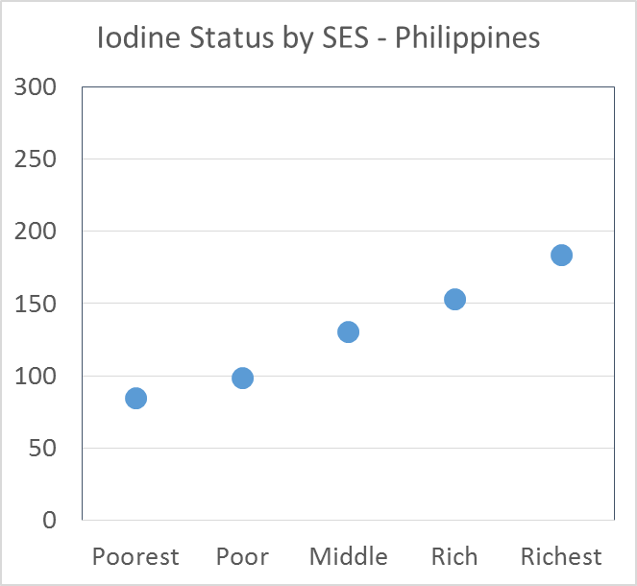
INTERPRETAción de datos de encuestas nacionales
Estado de yodo por estado socio-económico-Filipinas
PAÍS B
Más pobre Pobre Medio Rico Más rico
Notes:
This is another example
In the left graph you see the MUIC analysis by wealth quintile. Often we see that poorer segments of the population buy less expensive salt, this is often salt from small producers and poorly iodized. In this case the Philippines showed that indeed poorer household have a lower iodine status, even insufficient. This analysis is important because it helps to start looking at the program reasons and what improvements can be made.
The second graph is similar to the previous slide and shows the relationship between the level of iodization and the iodine status. We often see this relationship whereby the less iodine in the household salt the poorer the iodine status is. However, some of you will note that despite not having iodine in the household salt, the iodine status was still adequate. How come?
We should note that the iodine provided by salt used in processed foods is not taken into account in this analysis and is the likely reasons why the iodine status is still adequate: processed food contained salt that was iodized!

Slide 25
ESTADO DE YODO POR SUB-GRUPOS
Área geográfica/ Características demográficas | Número de muestras | Mediana de Concentración de Yodo Urinario
Nacional
Lugar
Urbano
Rural
Región/Provincia
Región/Provincia 1
Región/Provincia 2
Región/Provincia 3
Estatus socio económico
Quintil 1 (el más pobre)
Quintil 2
Quintil 3
Quintil 4
Quintil 5 (el más rico)
Contenido de sal yodada en hogares
Sin yodo (< 5 ppm)
Inadecuadamente yodada (5-14.9 ppm)
Adecuadamente yodada (15-40 ppm)
Sobre yodada (> 40 ppm)
Se recomienda que se mantenga la definición de “sin yodo” en diferentes entornos.
Las definiciones de
Inadecuado
Adecuado
Exceso de yodo
se deberían modificar basado en las normas/reglamentos nacionales.
25
Notes:
Here we show the suggested sub-group analysis that you should consider for your surveys

Slide 26
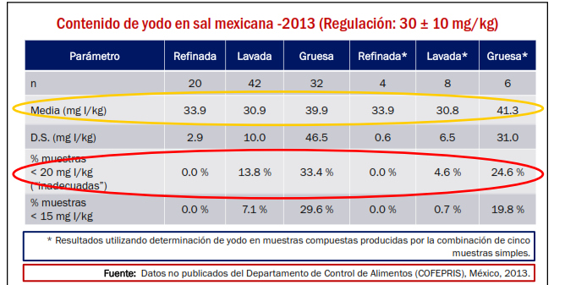
Variación del yodo en sal dependiendo de la Calidad de la sal (tipo de sal)
Cortesía del Dr. Omar Dary. Presentación en SLAN-2018. Guadalajara, México.

Slide 27
RecomendaCiÓn 6 – monitoreo del uso de sal yodada en los alimentos procesados y condimentos
Evaluar impacto
Estado de yodo (general, grupos vulnerables)
Definir la línea base
Estado de yodo,
Disponibilidad de sal y consumo
Utilización
Evaluar cobertura
META Nutrición óptima de yodo para todos
ESTRATEGIA: Yodar toda la sal de consumo humano
Sal de mesa
Sal en alimentos procesados
% hogares usando sal yodada.
Uso de sal yodada en alimentos procesados.
Monitorear el uso de sal yodada en alimentos procesados y condimentos
Monitoreo integral
Diseño de programa
Implementar programa
Objetivos
Legislación
Presupuesto de programa
% sal yodada
% industria de alimentos usando sal yodada
Yodación de la sal
Monitorear la calidad
Nivel de yodo en la sal en la cadena de suministro
Notes:
The next recommendation is about the need to be inclusive in our programs regarding processed food.
Here we see that the monitoring of processed food includes aspects of quality, scale and coverage of salt iodization programs.
This will help better understand the overall USI program, and where required, to revise standards

Slide 28
ingesta de yodo de alimentos procesados
País | Alimento | % del requerimiento de yodo proporcionado por el alimento procesado de la columna anterior
Egipto | Pan Baladi | 50%
Indonesia | Fideos instantáneos | 6%
 | Caldo | 4%
Ghana¹ | Cubitos de consomé | 68%
Haiti² | Cubitos de consomé | 79%
Filipinas | Pan | 8-10%
 | Fideos instantáneos | 7-9%
 | Pescado enlatado | 8-18%
 | Salsa soya | 8%
Federación Rusa | Pan | 37%
¹ Abizari: contribution of bouillon cubes to dietary iodine intake among children in northern Ghana; ² Gorstein: modelling potential iodine intake from bouillon cubes in Haiti;
All other data: Knowles et al. Iodine intake through processed food: case studies from Egypt, Indonesia, the Philippines, the Russian Federation and Ukraine, 2010-2015. Nutrients 2017
Notes:
Here we have some examples from countries on the actual processed food consumption and the salt intake. This was then converted into potential or actual iodine intake, meaning that the salt that carries or could carry iodine and thereby contributes to iodine intake. For example, baladi bread in Egypt is so widely consumed in such large quantities that the iodine intake, through the salt used in the bread baking, can contribute 50% of the daily iodine requirement.
It also shows that this is very country specific. Indonesians don’t eat much bread and therefore is not a key food for iodine intake

Slide 29
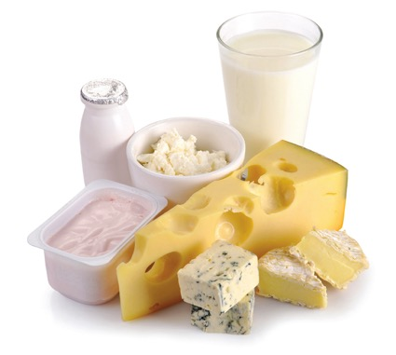
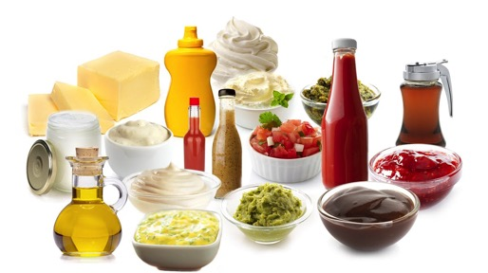
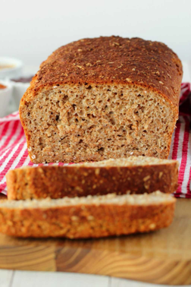
Evaluación de las fuentes de sal en la dieta
Consumo de alimentos que mas aportan a la ingesta de sodio-yodo
Informacion de disponibilidad de alimentos procesados que utilizan sal como ingrediente
Calidad de la sal utilizada por la industria de alimentos
Meta final: Que todos los segmentos de la población tengan una ingesta suficiente de yodo y revisar si se require de una modificación a los reglamentos/normas.
Notes:
The monitoring approach for the use of iodized salt in processed food is as follows:
First, it is important to monitor the iodine status and the main sources of iodine in the diet: household salt and food salt.
The monitoring of quality includes the actual use of iodized salt according to standards set for processed foods, often this is the same as for table/household salt, but in some cases it may be different. This data could be obtained from the suppliers of salt or from the food producers.
The monitoring of scale is conducted through finding out from the food producers the amounts of this type of food that is produced and also from consumption data. Often dietary intake surveys or household food expenditure surveys can provide that information.
Ultimate goals of monitoring are to confirm that population intake is sufficient, all segments of the population are being reached and to track whether changes in standards are required.

Slide 30
conclusión
La Guía proporciona herramientas programáticas para mejorar el monitoreo de los programas e interpretar los hallazgos.
El día de hoy se compartieron 6 recomendaciones, pero aún hay más en la Guía, así como herramientas prácticas para su uso.
Se les insta a utilizar la Guía, la cual está disponible en inglés, francés, español y ruso.
Soporte disponible para los programas:
    Por pares en otros países
    Por organizaciones internacionales y regionales (UNICEF, IGN, USAID,
    INCAP, Nutrición Internacional, GAIN, y otros)
PREGUNTAS

Slide 31
¡MUCHAS GRACIAS POR SU ATENCIÓN!

