Slide 2
introduction
Welcome to this webinar!
What can you expect?
Presentation – 50 minutes
Questions and comments – 20-30 minutes
In the next hour you will hear about …
Salt iodization programs
What has changed over time in iodine nutrition programs
Its implications for what and how we monitor performance and impact
What the key recommendations are from Guidance document
How you can use them in your work as program manager
Notes:
Welcome to the webinar on the Guidance on the Monitoring of Salt Iodization Programmes and Determination of Population Iodine Status.
What can you expect?
In the next hour we will have a presentation on the UNICEF “Guidance on monitoring salt iodization programmes and iodine status” that was issued in 2018.
The presentation will last about 50 minutes,.
After that there will be room for your questions and comments - for about 20-30 minutes.
We will try to monitor the questions that you can post in the chat box throughout the presentation. We will try to cover all questions we receive.
You will be muted centrally during the webinar. We will record the entire webinar and we will share this together with the presentation and other materials by email with all participants. It will also be posted on IGN’s website www.ign.org
This webinar is organized jointly by UNICEF and the Iodine Global Network (IGN). IGN has led the development of the materials used for this webinar.
We are happy to have representation from both UNICEF and IGN in this webinar
Let me take a moment to introduce the speakers and myself:
Roland Kupka from UNICEF HQ in New York. He is a senior adviser at UNICEF with a wealth of experience in nutrition and iodine in particular. He is joining us today from New York
Mawuli Sablah who is a nutrition specialist also based in UNICEF HQ, joining us from New York. He has a lot of programmatic experience in food fortification and micronutrients
Jonathan Gorstein who is the executive director of IGN, speaking from Nairobi Kenya but based out of Seattle US. He is an expert in iodine nutrition, with a particular strength in monitoring
I am Arnold Timmer, I work with IGN as a senior adviser, and am the moderator for this webinar. I have also a passion for iodine nutrition and learned a few things along the way
So, let us get started.
In the next hour you will hear about
Salt iodization programs
What has changed over time in iodine nutrition programs
Its implications for what and how we monitor performance and impact
What the key recommendations are from Guidance document
How you can use them in your work as program manager
I would like to emphasize that we will not be able to cover all the program aspects of iodine nutrition.
There are many many dimensions and experiences to this exciting program but that would take a long time to discuss…
We understand you will have other questions. We do want to hear these and we will respond separately.
UNICEF, IGN and other organization such as NI, GAIN, WFP are supporting iodine programs so please seek also advice from them.
So now, let me give the floor to Roland to say a few words on behalf of UNICEF.

Slide 3
background
Although a program guidance¹ exists, programs have evolved and there was a need for an update.
A technical working group was hosted by UNICEF to discuss research priorities for the monitoring of salt iodization programs and determination of population iodine status.
Objectives of the working group:
To identify knowledge gaps related to the monitoring of salt iodization and iodine nutrition programs
To reach consensus on selected issues related to the monitoring of salt iodization and iodine nutrition programs
Why was this review necessary?
¹ Assessment of IDD and monitoring their elimination, a guide for programme managers, 2007 WHO/UNICEF/ICCIDD
Notes:
A few words about the background of the Guidance.
Program guidance exists for iodine programs : this is the Assessment of IDD and monitoring their elimination a guide for programme managers, WHO/UNICEF/ICCIDD, 2007. The landscape has evolved however, there was a need for an update to support countries in their maturing programs
A technical working group was hosted by UNICEF to discuss research priorities for the monitoring of salt iodization programs and determination of population iodine status.
The technical working group consisted of experts and all key organizations involved in iodine nutrition
Funding was provided by USAID for the development of the Guidance
What were the objectives of the technical working group?
First to identify knowledge gaps related to the monitoring of salt iodization and iodine nutrition programs
Secondly, the group aimed to reach consensus on selected issues related to the monitoring of salt iodization and iodine nutrition programs
But an important question to answer first is why this review was actually necessary?

Slide 4
Salt Iodization- Original model
Original goal of Universal Salt Iodization: >90% coverage of households using adequately iodized salt (HHIS)
Implication: Eliminate Iodine Deficiency Disorders (IDD)
Household adequately iodized salt set at 15 ppm to meet daily requirement of 150 µg
Household Adequately Iodized Salt
National Iodine Status
(urinary iodine)
Notes:
In order to answer this question it is important to look at the original model of salt iodization.
The original model was focusing on the intake of iodine through iodized salt at household level to meet the needs and eliminate iodine deficiency. The Iodine status was mainly measured through urinary iodine among school aged children (SAC). SAC because this was an easy group to reach and concentrated in schools so often representative samples could be obtained this way.
We measure household coverage of salt with minimum iodine level of 15 mcg/kg. The assumption is that – physiological requirement of 150 µg per day for iodine can be provided through table/household salt, consumed on a daily basis, estimated at 10 g (10 x 15 ppm = 150 µg)
Intake of iodine through iodized salt at household level can help meet needs and eliminate deficiency
Measure two key performance indicators:
HHIS – adequately iodized salt at household level
UIC – iodine status of populations
The goal was to achieve 90% coverage of households using adequately iodized salt
The goal was to eliminate iodine deficiency disorders (IDD), in particular goitre, the most obvious clinical symptom of iodine deficiency

Slide 5
New model: Optimize iodine nutrition through different dietary sources of iodine
Salt iodization remains at the core to optimal iodine nutrition
Iodized Salt in Processed Foods & Condiments
Household Adequately Iodized Salt
Iodine in soil & water (affects iodine in local drinking water & agricultural products)
National Iodine Status
(urinary iodine)
Other micronutrient interventions (home fortification, maternal supplements..)
But we can no longer rely just on coverage of households using adequately iodized salt (HHIS) to assess and track program success. We also need to find out about iodized salt in processed foods and condiments
Notes:
The new program goal is to optimize iodine nutrition (versus the elimination of iodine deficiency disorders). Different dietary sources of iodine now play a role.
We now all know that the original model was too simplistic and doesn’t fit the reality of today’s salt intake anymore
The most important change is that processed foods has become an important contributor of salt intake in our diet, pretty much everywhere around the world.
This salt forms a significant part of our total salt intake and therefore needs to be included in the salt iodization approach if we want to ensure adequate iodine intake
We also observe that iodine appears in rare cases in water or agricultural products.
Further, there are now also other program interventions that provide iodine. For example, home fortification with micronutrient powder, targeting children < 2 years of age.
Or multi micronutrient supplements for women, or specialized food products such as blended foods or ready to use foods that are used in humanitarian settings or social safety nets.
These ‘other micronutrient intervention’ may not be significant but can fill important gaps and program managers need to be aware.
HOWEVER, salt iodization is and remains the core in the battle to eliminate iodine deficiency. We need to look at processed food in our program. We do not yet have a good monitoring tool yet to measure the use of processed foods with iodized salt, but tools are under development.
We need to keep the focus on the scale up of salt iodization and sustain what we have achieved

Slide 6
optimal iodine nutrition, not just Iodine Deficiency Disorders
When USI programs began, the focus was to prevent iodine deficiency disorders IDD (clinical signs like goiter)
Studies in 80s’ have shown that iodine deficiency irreversibly affects brain development during pregnancy.
→ Focus shifted to include visible and invisible signs
→ Focus shifted to adequate iodine for all
Increase in program data have shown decrease in iodine deficiency but also an increase of more than adequate iodine intake.
→ Focus now on optimal iodine nutrition, not too little and not too much.
We need tools and guidance to better track USI programs and ensure optimal iodine nutrition
Notes:
What have been the main milestones in iodine programming?
When USI programs began, the focus was on providing adequate iodine to prevent deficiency disorders (clinical signs like goiter), particularly in school age children
Studies in the 1980s showed the detrimental effect iodine deficiency has on brain development and focus shifted to all consequences to include the pregnancy period
As programs matured and more data on iodine status became available, deficiency decreased but some programs reported more than adequate intakes. Like inadequate intakes, this needs to be avoided because it affects thyroid function in a negative way → the focus of programs and program monitoring shifted to ensure adequate intake for all – not too little and not too much - hence the term ‘Optimal Iodine Nutrition’
Need to develop new tools and guidance to better track USI programs and ensure optimal iodine nutrition

Slide 7
What is success? quality, scale and impact
The salt iodization program is successful if it delivers iodized salt that is of the right quality (iodization level), has reached scale so everyone’s iodine needs are met and makes an impact (achieves optimum iodine nutrition):
minimizes the population that is deficient
minimizes the population that has more than adequate iodine intake
We need to have a program that is designed correctly AND implemented correctly in order to have the right impact
We depend on the right data to inform us
Notes:
The salt iodization program is successful if it delivers iodized salt that is of the right quality (iodization level), has reached scale so everyone’s iodine needs are met and makes an impact (achieves optimum iodine nutrition):
While doing this we need to make sure that we
minimize the population that is deficient
minimize the population that has more than adequate iodine intake
We need to have a program that is designed and implemented correctly in order to have the right impact
We depend on the right data to inform us

Slide 8
Salt iodization has been main strategy to achieve optimum iodine nutrition
Countries with optimal iodine nutrition from 8 to 121
Number of countries
Year
Notes:
Salt iodization is one of the most successful public health interventions ever!
We observe an increase in number of countries with optimal iodine intake from 8 to 121 and the number of countries declining with inadequate intake from 113 to 21.
It is also important to note that the number countries for which the IGN global scorecard has data on iodine status has increased from 121 to 155 over this same time period, so the denominator is getting bigger.

Slide 9
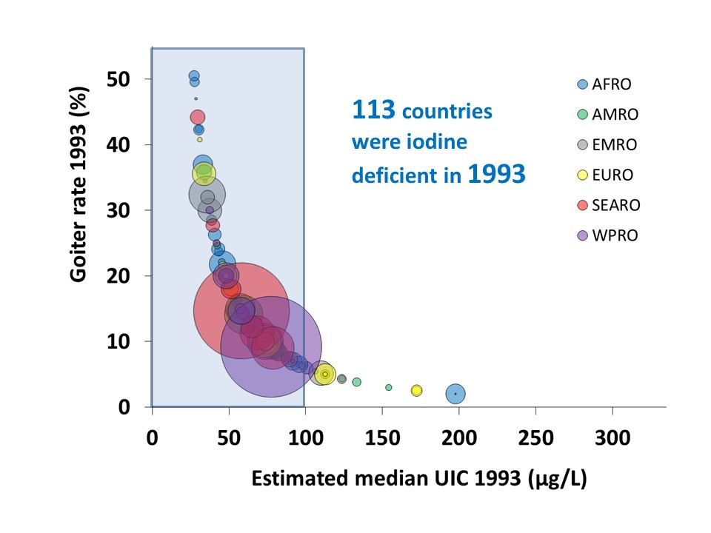
Changes in iodine deficiency over 25 years
Notes:
This graph shows the historical developments of iodine deficiency very well.
This figure shows the data from many countries in the world, 27 years ago in 1993. On the horizontal axis we see the median UIC while on the vertical axis we see the goiter rate.
The bubbles represent countries - The size of he bubble represents the population size of a country. The big ones are China and India for example.
The colour corresponds with the region of the world. WHO classification of regions was used.
In 1993 we can conclude that many countries were suffering from iodine deficiency disorders – high goiter rates – and the iodine status in the majority of countries was inadequate – the MUIC for many countries was < 100 mcg/L - 113 countries were iodine deficient
Now let us look 24 years later

Slide 10
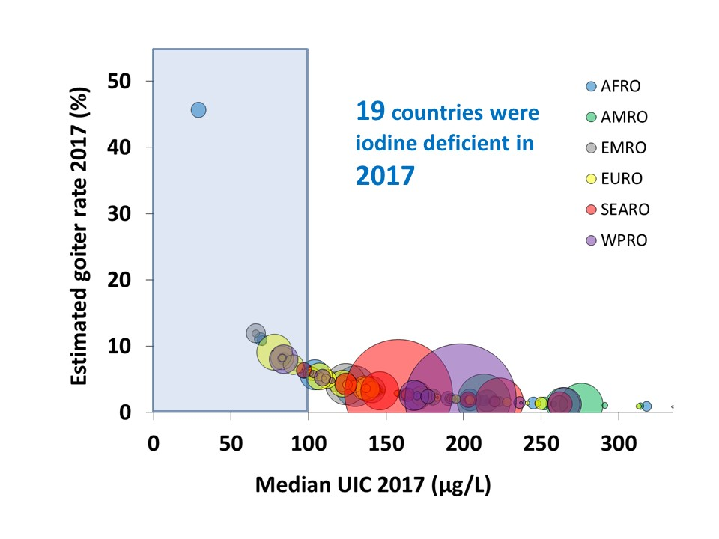
Changes in iodine deficiency over 25 years
Notes:
Now we are in 2017. The same data is presented here, horizontally the median UIC and the goiter rates vertically.
What is most striking is that the goiter rates have gone down for practically all countries with the exception of a few. The iodine status has also improved a lot. Now the majority of countries find themselves in the adequate iodine status range.
We now only have 19 iodine deficient countries (versus 113 in 1993)
The outlier blue spot is Angola
This impressive improvement is because of salt iodization. It is one of the most successful public health interventions that we have to date.
There are some countries that are not quite there yet. This makes it very clear that we are not done yet, the job is not finished. We need to bring those countries also in the iodine sufficient range. At the same time we need to ensure that the other programmes are sustained

Slide 11
iodine nutrition programs – quality, scale and impact
Evaluate Impact
Increase coverage
Sustained achievements
Iodine status
Iodine status by program use
Define baseline
Iodine status
salt supply & consumption
Utilization
Assess coverage
GOAL optimum iodine nutrition for all
Strategy: iodize all edible salt for human use
Table salt
Salt in processed food
% households using iodized salt
Use iodized salt in processed food
Expand salt Iodization
Ensure goal is achieved
Design program
Monitor scale
Implement program
Targets
Legislation
Management
budget
% salt iodized
% food producers using iodized salt
Salt iodization
Adjustment of Standards
Improve compliance
Monitor quality
Iodine level in salt in supply chain
Notes:
Let us now take a look at the program steps in more detail so we can determine how we measure quality, scale and impact
Goal and Strategy
The goal is to achieve and sustain optimum iodine nutrition, for all! This means that the proportion of people with deficiency should be minimized, but also the proportion with excess should be minimized, for different population groups at the same time
Define baseline
Initially, baseline Information was collected on iodine status which expressed the iodine deficiency problem and which triggered the need to address this by the program intervention iodization of all edible salt for human (and animal) consumption.
In order to achieve this goal, the salt supply needed to be mapped and today, as has become more prominent, also the consumption of processed foods.
Design Programs
Then, based on the knowledge of supply and consumption the program is designed which sets targets for salt iodization, the types of processed foods to be included, and fix this in legislation, regulations and the way to enforce. Important also is to ensure the coordination and management of the program is set up PLUS an allocated budget for the implementation of the program
Implement program
The implementation of the program aims to scale up salt iodization for table salt and use in processed food
Utilization
The iodized salt is utilized in the form of table salt used in the household for cooking and added on the table. Iodized salt is also utilized in processed food production.
The monitoring of program effectiveness and impact addresses all aspects of the program:
Monitor quality
The quality of iodization needs to be monitored through checking iodine levels along the supply chain at production, importation, export, processing and at the market levels
Monitor scale
Not just quality but also scale is important. It is important to determine the extent to which the program has been implemented: the proportion of edible salt that is iodized and the proportion of food producers that use iodized salt
Assess coverage
Then, assessing coverage provides feed back on the households that use iodized salt and the targeted food industries that use iodized salt
Evaluate Impact
Finally, the impact of the program shows the effectiveness among vulnerable groups (school aged children, pregnant women and women of child bearing age). It is important to determine the magnitude of deficiency but also excess
Now, what can the monitoring data be used for?
-It can help to improve compliance of salt producers to iodize their salt according to standards
-It can help to expand salt iodization and use of iodized salt by food industry
-it can help to identify problem areas where the coverage is low
-it can help to know if the salt iodization standards are correct if we know the iodine status among those that use iodized salt, and if not, to adjust the standards
-it can help to assess if the goal of optimum iodine nutrition was reached
-it can help to make sure the achievement is sustained

Slide 12
recommendation 1 – use of Rapid test kits
Evaluate Impact
Iodine status
Iodine status by program use
Define baseline
Iodine status
salt supply & consumption
Utilization
Assess coverage
GOAL optimum iodine nutrition for all
Strategy: iodize all edible salt for human use
Table salt
Salt in processed food
% households using iodized salt
Use iodized salt in processed food
Rapid test kits (RTKs) are used for:
Monitoring quality
Assessing coverage
Education purposes to raise awareness
Design program
Monitor scale
Implement program
Targets
Legislation
Management
budget
% salt iodized
% food producers using iodized salt
Salt iodization
Monitor quality
Iodine level in salt in supply chain
Notes:
So given this background, what were some of the key recommendation which emerged from the Expert meeting and how do these align with the monitoring and program needs presented just now?’.
Using this program model, we will now explain the key recommendations from the Guidance document.
The first one is: Correct use of Rapid test kits (RTKs).
In the program model we see that RTKs have been used for monitoring quality (at the supply and market levels) and for assessing coverage. They are also often used for education purposes at school or by consumer groups to check if the salt they buy is iodized.

Slide 13
Correct use of Rapid test kits
Rapid test kit (RTK) is a chemical solution. A few drops on salt turns it blue when iodine is present. It is field friendly and easy to use
BUT - It has been incorrectly used to distinguish inadequately from adequately iodized salt (confirmed by many studies¹)
It is good to tell if there is iodine in the salt: yes or no, for example for education purposes
RTKs should only be used to differentiate between non-iodized and iodized salt - not to measure the actual iodine content!
¹ Performance of rapid test kits to assess household coverage of iodized salt. Gorstein et al, Public Health Nutrition 2016
Notes:
I think everyone has seen and used these RTKs as shown in this picture. This is the most commonly used RTK. As you can see there are 3 different options shown: white (without iodine), light blue (below 15 ppm) and darker blue (above 15 ppm).
It is a chemical solution (acid and starch reacts with iodine turning it blue) that works by putting a few drops on salt. When there is iodine it turns different shades of blue. It is known for its ease of use and is therefore very field friendly.
Now, this device depends on an observed change in colour as measured by the human eye. So it is only good enough to tell if there is any iodine in the salt. It has also been incorrectly used to distinguish inadequately from adequately iodized salt. Multiple studies have shown that the RTK is not suitable to determine the amount of iodine in salt (adequate – inadequate)
RTKs therefore should only be used to differentiate between non-iodized and iodized salt and not to measure the actual iodine content!
If you want to determine the exact amount of iodine use titration, the WYD checker machine or other available devices
If you only want to test the presence of iodine then the test kit is still very suitable.
Bottomline, we need to use the method what they are designed for and not misuse them.

Slide 14
Recommendation 2 – Acceptable range for urinary iodine
The acceptable range of median UIC (MUIC) in monitoring iodine status of school aged children
Evaluate Impact
Iodine status
Iodine status by program use
Define baseline
Iodine status
salt supply & consumption
Utilization
Assess coverage
GOAL optimum iodine nutrition for all
Strategy: iodize all edible salt for human use
Table salt
Salt in processed food
% households using iodized salt
Use iodized salt in processed food
Design program
Monitor scale
Implement program
Targets
Legislation
Management
budget
% salt iodized
% food producers using iodized salt
Salt iodization
Monitor quality
Iodine level in salt in supply chain
Notes:
Now let us move on to the 2nd recommendation: 2. The acceptable range of median UIC in monitoring iodized salt programs
In the program model, we see that this recommendation relates to the assessment of iodine status. And is important for evaluating the impact salt iodization and ensure optimum iodine nutrition for all.

Slide 15
Summary of a multi-country study
Median urinary iodine concentration (MUIC) is a biomarker of iodine intake
MUIC in school aged children, in the past:
mUIC of 100–199 μg/L indicates ‘adequate’ iodine intake
mUIC 200–299 μg/L indicates ‘more than adequate’ iodine intake (WHO)
In a 12 country study¹, the association between UIC and markers of thyroid function was assessed among 2500 school aged children
Risk of thyroid dysfunction increases with iodine deficiency (UIC <100 μg/L) and iodine excess (UIC >300 μg/L)
Between 100 and 299 μg/L thyroid function is normal
The acceptable range of MUIC in monitoring iodine status of school aged children can be safely widened to 100 to 299 μg/L!
¹ Zimmermann et al. Thyroglobulin is a sensitive measure of both deficient and excess iodine intakes in children and indicates no adverse effects on thyroid function in the UIC range of 100-299 μg/L: a UNICEF/ICCIDD study group report. J Clin Endocrinol Metab. 2013 Mar;98(3):1271-80
Notes:
We will explain this recommendation using a multi- country study from 2013.
We know that median urinary iodine concentration (MUIC) is a biomarker of iodine intake.
For school aged children, in the past:
MUIC in the range 100–199 μg/L ‘adequate’ iodine intake and the range of 200–299 μg/L indicates ‘more than adequate’ iodine intake among school aged children (WHO).
This range was an estimate and never grounded in the functioning of the thyroid glad or negative consequences.
In a 12 country study, the association was assessed between UIC and thyroid function among 2500 school aged children
Over a range of iodine intakes from severely deficient to excessive, risk of thyroid dysfunction increased in children with iodine deficiency (UIC <100 μg/L) and iodine excess (UIC >300 μg/L)
In the ranges of 100-299 μg/L the thyroid function was normal.
This means that there was no difference between the 100-199 and the 200-299 mcg/L range. Therefore, the 2 ranges can be combined into one.
The acceptable range of median UIC in monitoring iodized salt programs could be safely widened to 100 to 299 μg/L!
This in turn is important when trying to bring other population groups like pregnant women (who have higher requirements) into an adequate range while not pushing school aged children into excess. This study has shown that the room to maneuver is larger than previously thought.

Slide 16
Recommendation 3 – Population status
Evaluate Impact
Iodine status
Iodine status by program use
The median urinary iodine concentration (MUIC) to define population iodine status
Define baseline
Iodine status
salt supply & consumption
Utilization
Assess coverage
GOAL optimum iodine nutrition for all
Strategy: iodize all edible salt for human use
Table salt
Salt in processed food
% households using iodized salt
Use iodized salt in processed food
Design program
Monitor scale
Implement program
Targets
Legislation
Management
budget
% salt iodized
% food producers using iodized salt
Salt iodization
Monitor quality
Iodine level in salt in supply chain
Notes:
The third recommendation is also about the use of urinary iodine concentration as an indicator of iodine status which is important in defining the baseline of the program and to track changes over time.
With currently available methods, the analysis and interpretation of urinary iodine concentration (UIC) can only be used to define population iodine status and not to quantify the proportion of the population with iodine deficiency or iodine excess.

Slide 17
urinary iodine – used for populations, not for individuals
The concentration of iodine excreted in urine (UIC) is an indicator of iodine intake
The assessment of UIC is typically assessed in spot urine samples
Because of the variation in individual iodine intake, UIC data can only be presented for the entire population (presented as the median UIC) and cannot be used to classify individuals
The median value provides a reflection of the status of the entire population
Notes:
The concentration of iodine excreted in urine (UIC) is an indicator of iodine intake. Although an individual’s urinary iodine concentration can vary daily, or even within the same day, these variations tend to even out within populations, providing a useful measure of the iodine status of populations.
The assessment of UIC is typically assessed from spot urine samples measured at one point during the day.
Because of the variation in individual iodine intake, UIC data can only be presented for the entire population (presented as the median UIC) and cannot be used to classify individuals
The median value provides a reflection of the status of the entire population

Slide 18
Use of Median urinary iodine
The use of percentages of low and excessive iodine intake has been problematic and provide a misleading impression of population status.
Example
In a population the median UIC = 120 ug/L, but 40% of values are < 100 ug/L and 10% are > 300 ug/L
The median UIC in this example is classified as optimal since it falls in the range of 100-299 ug/L
We cannot say that 40% is deficient or 10% has excess
With currently available methods, the analysis and interpretation of mUIC cannot be used to quantify the proportion of the population with iodine deficiency or iodine excess.
Notes:
The use of percentages of low and excessive iodine intake has been used in the past and is problematic and provides a misleading impression of population status
A common practice has been to label the % < 100 mcg/L as deficient.
This is methodologically incorrect for the reason that we just said, that is, when the median > 100 ug/L, it implies that the entire population is labeled as having an adequate status.
If for example the median is 120 ug/L and 40% of values fall below 100 ug/L we cannot label these as deficient since they belong to the same population and all are sufficient.
Therefore do not classify different segments of the population using the UIC below or above a certain cut off point.

Slide 19
Current iodine status criteria
Epidemiologic criteria for assessing iodine nutrition based on median urinary iodine concentrations in different target groups
 | MUIC (ug/L)
Population group | Insufficient | Adequate | Above requirement and excessive
School aged children | <100 | 100-299ª | > 300ª
Adults (women reproductive age) | <100 | 100-299ª | > 300ª
Pregnant women | <150 | 150-249 | > 250
Lactating women | <100 | > 100
Children < 2 years | <100 | > 100
ª adjusted based on best available scientific evidence to date
Source: WHO. Urinary iodine concentrations for determining iodine status deficiency in populations. Vitamin and Mineral Nutrition Information System. Geneva: World Health Organization; 2013 (http://www.who.int/nutrition/vmnis/indicators/urinaryiodine, accessed 3 October 2019).
Notes:
This table provides an overview of the current iodine status categories (insufficient, adequate and above requirement and excessive) recommended by WHO for different population groups.
For iodine status surveys, women of reproductive age should be the focus, along with pregnant women since this provides an impression of the iodine status not only for them, but also for the unborn child.
For purposes of comparison with previous surveys, school aged children are often also included.

Slide 20
Recommendation 4 – Iodine status by population groups
Assess Iodine intakes among different population groups
Evaluate Impact
Iodine status
Iodine status by program use
Define baseline
Iodine status
salt supply & consumption
Utilization
Assess coverage
GOAL optimum iodine nutrition for all
Strategy: iodize all edible salt for human use
Table salt
Salt in processed food
% households using iodized salt
Use iodized salt in processed food
Design program
Monitor scale
Implement program
Targets
Legislation
Management
budget
% salt iodized
% food producers using iodized salt
Salt iodization
Monitor quality
Iodine level in salt in supply chain
Notes:
This 4th recommendation also relates to the assessment of iodine status The question is: whether it is important to assess iodine status in more than 1 population group?
It is important to note that an adequate iodine status for one age group may not necessarily mean that iodine status is adequate for all age groups. This is especially important for pregnant women whose requirements are higher and for whom it is especially important to ensure optimal iodine intake.

Slide 21
Iodine status among different population groups
Example 1 of national MUICs among different population groups
 | MUIC (ug/L)
Population group | Insufficient | Adequate | Above requirement and excessive | Classification of status
School aged children |  | 163 |  | Adequate
If you only collected information on school aged children you will conclude that the ‘iodine status is categorized as adequate’
Notes:
Let us look at an example where the iodine status of school aged children is classified as adequate because the MUIC is 163 mcg/L which falls within the range 100-299 mcg/L. Conclusion would be that the iodine status is adequate and the salt iodization program is meeting its objectives

Slide 22
Iodine status among different population groups
Example 1 of national MUICs among different population groups
 | MUIC (ug/L)
Population group | Insufficient | Adequate | Above requirement and excessive | Classification of status
School aged children |  | 163 |  | Adequate
Pregnant women | 113 |  |  | Insufficient
But now we also have data on pregnant women:
Iodine status is categorized as adequate for school aged children
Iodine status is insufficient for pregnant women → this needs attention
As resources allow, the adequacy of iodine intakes should be examined among different subsets of the population, especially among groups vulnerable to deficiency
Notes:
However, in this example, a country also collected data on pregnant women and noted that the MUIC was only 113 mcg/L which is below the adequacy level for pregnant women which is 150-249 mcg/L
So, now our conclusion is different: SAC iodine status is adequate but pregnant women are not fully protected yet.
In this country they also observed that the iodine content from iodized salt was too low to meet the needs of pregnant women. They then took corrective action to bring pregnant women in the adequate range.
Conclusion:
an adequate iodine status for one group does not guarantee an adequate iodine status for others
As resources allow, the iodine status should be examined among different age groups, especially among groups vulnerable to deficiency

Slide 23
Recommendation 5 – Iodine status by sub-groups
Evaluate Impact
Examine the median urinary iodine concentration (MUIC) by subgroups
Iodine status
Iodine status by program use
Define baseline
Iodine status
salt supply & consumption
Utilization
Assess coverage
GOAL optimum iodine nutrition for all
Strategy: iodize all edible salt for human use
Table salt
Salt in processed food
% households using iodized salt
Use iodized salt in processed food
Design program
Monitor scale
Implement program
Targets
Legislation
Management
budget
% salt iodized
% food producers using iodized salt
Salt iodization
Monitor quality
Iodine level in salt in supply chain
Notes:
The 5th recommendation also is about MUIC and relates to the importance of looking beyond national averages and see how sub-groups are performing

Slide 24
INTERPRETATION OF NATIONAL SURVEY DATA
National level data are useful to track overall progress, but may hide disparities, and sub-national variations
Many countries have adequate iodine status, but there are sub-populations with inadequate status – unprotected
Such data help identify disparities and guide where program enhancements are needed and will become increasingly important following industry reform
Notes:
National level data are useful to track overall progress, but may hide disparities, and sub-national variations
While many countries have adequate iodine status, there may be sub-populations with inadequate status and are unprotected
against the consequences of ID
By undertaking sub-group analysis it is possible to identify disparities and guide where program enhancements are needed

Slide 25
INTERPRETATION OF NATIONAL SURVEY DATA – country example
Household iodine content | Coverage (%) | Median UIC (ug/L)
No iodine (0 ppm) | 17%
Inadequate iodine (1-14 ppm) | 33%
Adequate iodine (> 15 ppm) | 50%
All | 100% | 130
In case you only look at the MUIC of the entire population without taking into account whether they had iodized salt at home or not, the conclusion would be:
MUIC is “optimal” and the country qualified as iodine sufficient
Notes:
This is an example using data from a country. As you can see the HHIS coverage was 83%, (salt with any iodine in it) while the % of HH with adequately iodized salt was 50%. In this same population, t mUIC among schoolage children was 130 mcg/L, which is qualified as sufficient.
These are the two main parameters that many surveys report, but they lead to a confusing picture of the program performance.

Slide 26
INTERPRETATION OF NATIONAL SURVEY DATA – country example
Household iodine content | Coverage (%) | Median UIC (ug/L)
No iodine (0 ppm) | 17% | 78
Inadequate iodine (1-14 ppm) | 33% | 136
Adequate iodine (> 15 ppm) | 50% | 155
All | 100% | 130
Now, when you also know the MUIC for the the level of iodine in their salt: the MUIC can be found in the right column.
Conclusions
For households that don’t get iodized salt: improve quality of iodization
For those that get the right level of iodized salt: iodine status is adequate → the iodization level of salt is correct
Iodized table salt is likely the main source of iodine: if processed food salt was an important source, we would see higher MUIC for households with table salt with no iodine
Examine the MUIC in relevant subgroups, National-level MUIC may mask subnational disparities
Notes:
Further investigation shows the following
By stratifying the mUIC by salt iodine content, it is clear that those HH’s consuming non-iodized salt had an iodine status that was deficient (MUIC is 78 mcg/L) and those consuming inadequately iodized salt had lower MUIC than those consuming adequately iodized salt.
What does this tell us?
This country needs to improve quality of iodization and reduce number of households that don’t get iodized salt
Iodization level is correct: MUIC for those getting the right level of iodized salt have sufficient iodine status
Iodized table salt is main source of iodine. If processed food salt was an important source, you would see higher MUIC for those with salt with 0 ppm iodine
Examine the MUIC in relevant subgroups, National-level MUIC may mask subnational disparities

Slide 27
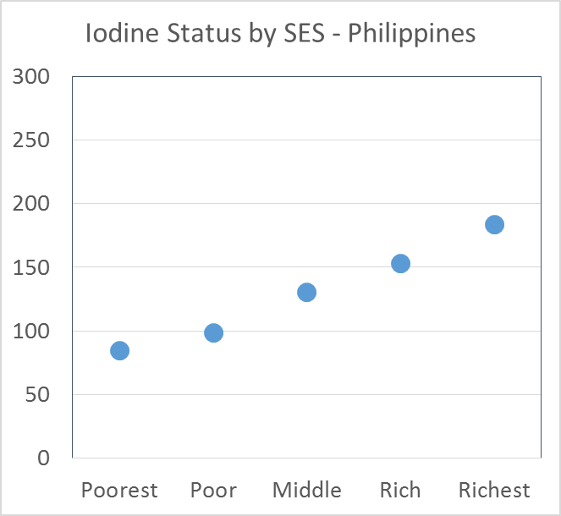
INTERPRETATION OF NATIONAL SURVEY DATA
In this example: poorer household likely use salt that is non-iodized or poorly iodized
Blue box represents range of optimal status
Notes:
This is another example
In the graph you see the iodine status stratified by an indicator of wealth. Often we see that poorer segments of the population buy less expensive salt, which is often from small producers and poorly iodized. In this example which present data from the Philippines, poorer households had lower iodine status, even insufficient. This analysis is important because it helps to start looking at the program reasons and what improvements can be made.

Slide 28
iodine status for sub-groups
Geographic area/ Demographic characteristic | Number of samples | Median Urinary Iodine Concentration
National
Location
Urban
Rural
Region/Province
Region/Province 1
Region/Province 2
Region/Province 3
Economic status
Quintile 1 (poorest)
Quintile 2
Quintile 3
Quintile 4
Quintile 5 (richest)
Salt iodine content (HHIS)
Non iodized (< 5 ppm)
Inadequately iodized (5-14.9 ppm)
Adequately iodized (15-40 ppm)
Over iodized (> 40 ppm)
28
Notes:
The table provides an example of a number of suggested sub-group analysis that you should consider for your surveys
It includes a several important variables, and where there are differences in iodine status, it could help target resources and appropriate actions

Slide 29
Recommendation 6 – monitor processed foods and condiments
Evaluate Impact
Iodine status
Iodine status by program use
Define baseline
Iodine status
salt supply & consumption
Utilization
Assess coverage
GOAL optimum iodine nutrition for all
Strategy: iodize all edible salt for human use
Table salt
Salt in processed food
% households using iodized salt
Use iodized salt in processed food
Design program
Monitor scale
Monitor the use of iodized salt in processed foods and condiments.
Implement program
Targets
Legislation
Management
budget
% salt iodized
% food producers using iodized salt
Salt iodization
Monitor quality
Iodine level in salt in supply chain
Notes:
The 6th recommendation is about the need to be inclusive in our programs and consider the use of iodized salt in processed food and condiments which has become increasingly important as salt consumption patterns change.
Here we see that the monitoring of processed food includes aspects of quality, scale and coverage of salt iodization programs.
This will help better understand the overall USI program, and where required, to revise iodization standards

Slide 30
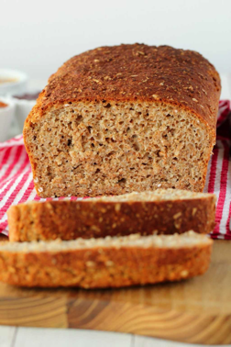
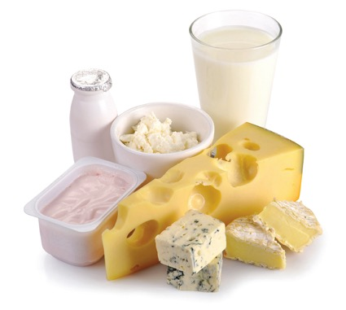
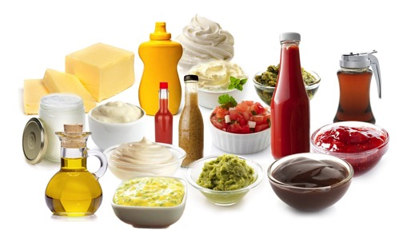
Assessment of sources of salt in the diet
Monitoring approach
Monitor iodine status
Monitor the main sources of iodine in the diet: household salt and food salt
Monitor food salt quality – possible → supply side
Monitor scale of processed foods with iodized salt – possible → supply information
Ultimate goal: population intake sufficient, all segments of population reached and see whether iodization level requires to be changed
Notes:
As we have emphasized in the previous slides, the most critical indicator of salt iodization program performance is the iodine status of populations.
To better understand the major inputs which contribute to iodine status, it is important to monitor the main sources of iodine in the diet: household salt and salt in processed foods.
For this, you should continue to assess the coverage of iodized salt at the household level, and this remains a critical program indicator and is included in the UNICEF global database.
In addition, it could be helpful to understand the main sources of salt in processed foods and condiments, such as bread, instant noodles or bouillon. Once this is determined, it would be important to know whether the salt used in the manufacture of these products is iodized or not as this could influence the overall iodine intake in the diet
For routine program monitoring, the focus should only be on the most important sources of salt used by the food industry and how these could be integrated into the overall USI program.
Finally, as salt consumption patterns change, and we consider the relative contribution from household discretionary salt and that used by the food industry, it is important to reinforce the close alignment of salt iodization with salt reduction strategies.
The ultimate goals of monitoring are to confirm that population intake is sufficient, all segments of the population are being reached, the overall salt intake in the diet, and use this information to determine whether changes in standards are required.

Slide 31
iodine intake from processed foods
Country | Food | % of iodine requirement provided by processed food in previous column
Egypt | Baladi bread | 50%
Indonesia | Instant noodles | 6%
 | Stock | 4%
Ghana¹ | Bouillon cubes | 68%
Haiti² | Bouillon cubes | 79%
Philippines | Bread | 8-10%
 | Instant noodles | 7-9%
 | Canned fish | 8-18%
 | Soy sauce | 8%
Russian Federation | Bread | 37%
¹ Abizari: contribution of bouillon cubes to dietary iodine intake among children in northern Ghana; ² Gorstein: modelling potential iodine intake from bouillon cubes in Haiti;
All other data: Knowles et al. Iodine intake through processed food: case studies from Egypt, Indonesia, the Philippines, the Russian Federation and Ukraine, 2010-2015. Nutrients 2017
Notes:
Here we have some examples from countries on the potential or actual iodine intake through the use of iodized salt in these products.
For example, baladi bread in Egypt which is widely consumed in large quantities and can contribute up to 50% of the daily iodine requirement because the salt used in its preparation is iodized..
It also shows that this is very country specific. Indonesians don’t eat much bread and therefore is not a key food for iodine intake
You can also note the important contribution of iodine from iodized salt used in bouillon cubes contributing as much as 2/3 to ¾ of the iodine requirement for Haiti and Ghana.
New program guidance has been developed by IGN to assess the use of iodized salt in processed foods and condiments

Slide 32
conclusion
The Guidance provides you with programmatic tools to better monitor your programs and interpret the findings
We shared 6 key recommendations today. There are more recommendations and practical tools for your use in the Guidance
Please use this Guidance. It is available in English, French, Spanish and Russian
Please know that support for your programs is available:
By peers in other countries
By international organizations (UNICEF, IGN, Nutrition International, GAIN, WFP, etc)
Thanks to donor agencies to make this webinar possible:
Gates Foundation, GiveWell, USAID, Kiwanis International
Now is your chance to ask questions
Notes:
The Guidance provides you with programmatic tools to better monitor your programs and interpret the findings
We shared 6 key recommendations today. There are more recommendations and practical tools for your use in the Guidance
Please use this Guidance. It is available in English, French, Spanish and Russian
Please know that support for your programs is available:
By peers in other countries
By international organizations (UNICEF, IGN, Nutrition International, GAIN, WFP, etc)
Thanks to donor agencies to make this webinar possible:
Gates Foundation, GiveWell, USAID, Kiwanis International
Now is your chance to ask questions

